Slide 1
How to Get Started with My Health Checklist
October 2025
IHI.org/AgeFriendly

Slide 2
What's in Here
Click to jump to any section:
Why It Matters
Printing the Checklist
Share the Checklist with the Community
Core Principles
Preparing for Conversations about Completed Checklists
Sample Presentation
Stories (First Impressions) | Stories (Using the Checklist)

Slide 3
About These Slides
These slides contain tips and ideas for using My Health Checklist.
Skip around and use them in any order.
You're welcome to use these slides for your own presentations. We might suggest starting with this Sample Presentation.
“How to Get Started with My Health Checklist” supported by AARP. My Health Checklist is an Age-Friendly Health Systems resource for older adults, made possible through funding from The John A. Hartford Foundation. Learn more at ihi.org/AgeFriendly.

Slide 4
Why It Matters

Slide 5

What staff and older adults want
What brings staff the greatest satisfaction in their jobs is being able to deliver ideal patient experiences.
Older adults want collaboration, kindness, and respect from their care team. And, to be active participants in their care.
99% of adults 50+ say that in the event of a serious illness, it’s important that What Matters be the primary consideration for their care.
Massachusetts Coalition for Serious Illness Care consumer experience and messaging research, 2019 and 2020–2021. http://maseriouscare.org/research
Locock L, Graham C, King J, et al. Understanding how front-line staff use patient experience data for service improvement: an exploratory case study evaluation. Southampton (UK): NIHR Journals Library; 2020 Mar. (Health Services and Delivery Research, No. 8.13.) Available from: ttps://www.ncbi.nlm.nih.gov/books/NBK554766/
The John A. Hartford Foundation, November 2023.

Slide 6

Prioritizing these conversations around care can lead to...
…Better care alignment
…Better outcomes, high-quality care
…Trust and relationship building
…More activated/prepared older adults
…Better communication/connection between older adults and the health care team

Slide 7
A Conversation Starter
My Health Checklist is designed to help older adults get the most out of their medical appointments. It helps older adults think through all aspects of their health — what’s going well, what could be better, and their questions or concerns. It then helps them prioritize their top questions about what matters most to them.
The checklist doesn’t go into detail about specific health conditions or health care treatments. Use the checklist as a conversation starter to identify the top priorities.
Bring your experience and expertise to the conversation. Keep the person being cared for at the center.

Slide 8
Printing the Checklist

Slide 9
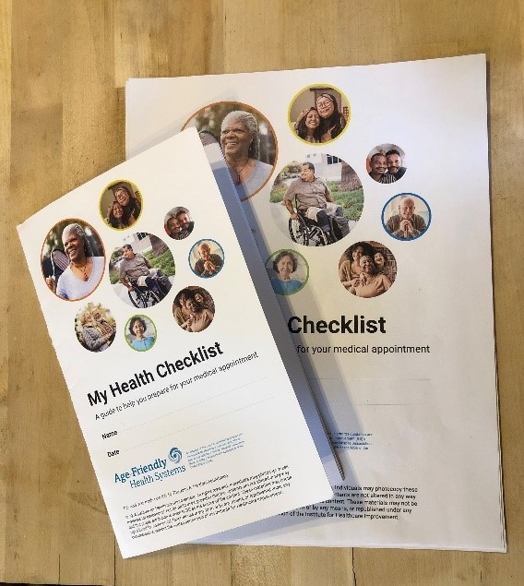
Ways to Print the Checklist
Print the PDF on any printer on 8.5” x 11” paper
To make the font larger: on a Mac computer, press print and click on “Scale to Fit”; or on a Windows computer, press print and click on “Fit”
Then, for a booklet, find the option for "pages per sheet" or "multiple pages" and choose two pages per sheet. After printing, fold the papers in half.
Bring the PDF to your local printer (e.g., FedEx, Staples). We recommend these booklet specifications:
5.5” x 8.5” saddle stitched; full duplex; 100 lb card stock covers; 24 lb paper inside
Order professionally printed copies via our online store
The team at Hudson found it helpful to print the checklist as a booklet (left), which they said made it compact and easy to carry. You can also print in a larger size (right).

Slide 10
Printing the Checklist – Funding Ideas
Print copies for events with a printing budget (e.g., conferences, nursing or geriatric symposiums). Any extras can be placed in waiting rooms or handed out.
Include the checklist with materials printed for a particular event (Annual Wellness Visit, new GI patient welcome packet, health fair)
Share the checklist with Community Health Workers to bring to advance care planning visits

Slide 11
Share the Checklist with the Community

Slide 12
Partner with the Community
Tip: Is there anyone at your site already working within or connected to your community? Think about advance care planning, social workers, community benefits, support group members, volunteers, palliative care, or home health staff.
Who in your community already meets with or supports older adults?
Look for locally-based organizations where older adults gather, or organizations that work with older adults, to meet them where they are.
Senior or aging initiatives through your local or state government may be interested in sharing a ready-made tool.

Slide 13
Ways to Partner with the Community
Partner with a community organization (health plan/insurer, senior center, senior living facility, Meals on Wheels)
Community organizations may be able to host in-person or virtual events
Consider organizations that may have a print shop that you can use in exchange for sharing this resource, such as a city/state/county office, Area Agency on Aging, Office of Aging, or Department of Health
Presbyterian Healthcare Services in New Mexico is working with their health plan to provide copies during care coordination visits.

Slide 14
Ideas
Senior center, Area Agency on Aging, AARP state office
Community health fair
YMCA, fitness center, Silver Sneakers group
Meals on Wheels or similar services
Independent living, assisted living, and long-term care facilities
Places of worship and faith leaders
Gatherings of family caregivers

Slide 15
Community Partnership Perspective
At Hudson Hospital and Clinic, Joy Hughes, RN Care Management Coordinator, and Megan Hundertmark, PharmD, Inpatient Pharmacist, are introducing My Health Checklist over a series of meetings. At an assisted living facility and long-term care facility, the session was listed on the activity board amongst bingos and other activities. “We had a very positive response,” says Hughes.
The Hudson team sat in the dining room, and centers brought residents in who they thought would be interested, as well as their spouses in some cases. People of all cognitive abilities joined the activity. Residents took time to fill out the checklist on the spot.

Slide 16
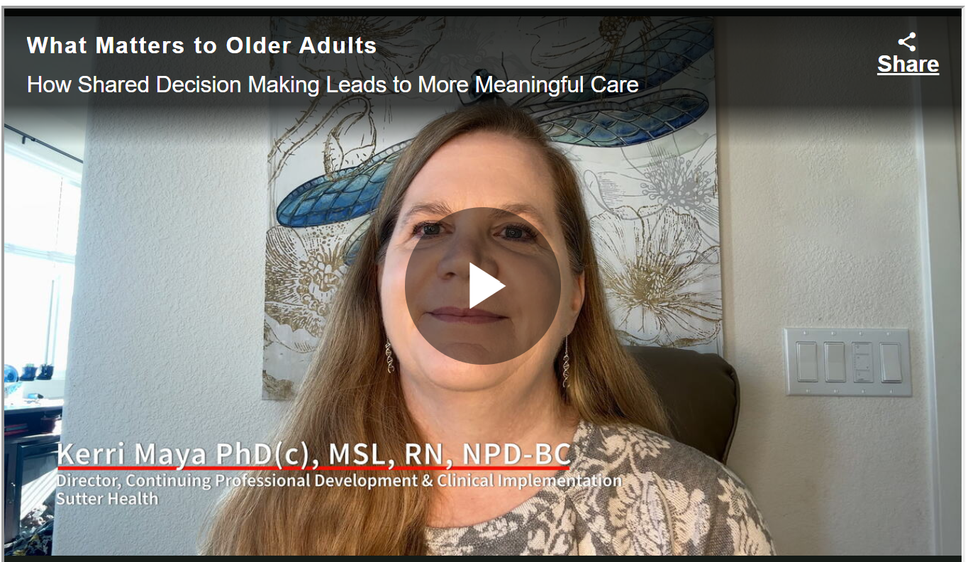
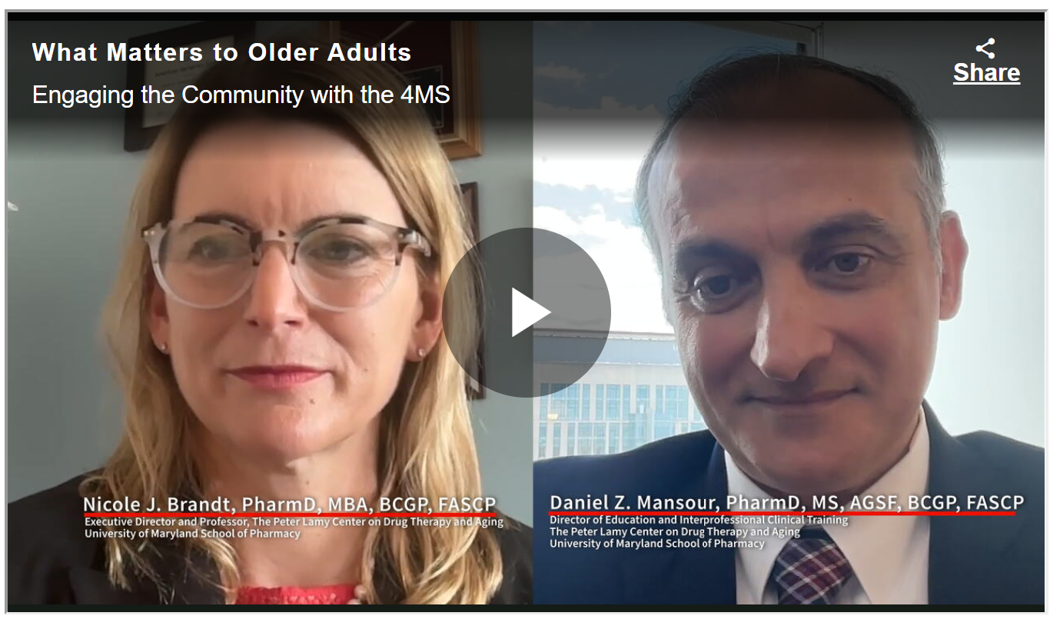
Other Resources
Resources from AARP, including two videos of providers talking about how shared decision-making leads to more meaningful care and engaging the community with the 4Ms
Notes:
Other resources:
Watch these two videos of providers talking about how My Health Checklist supports meaningful conversations and better care

Slide 17
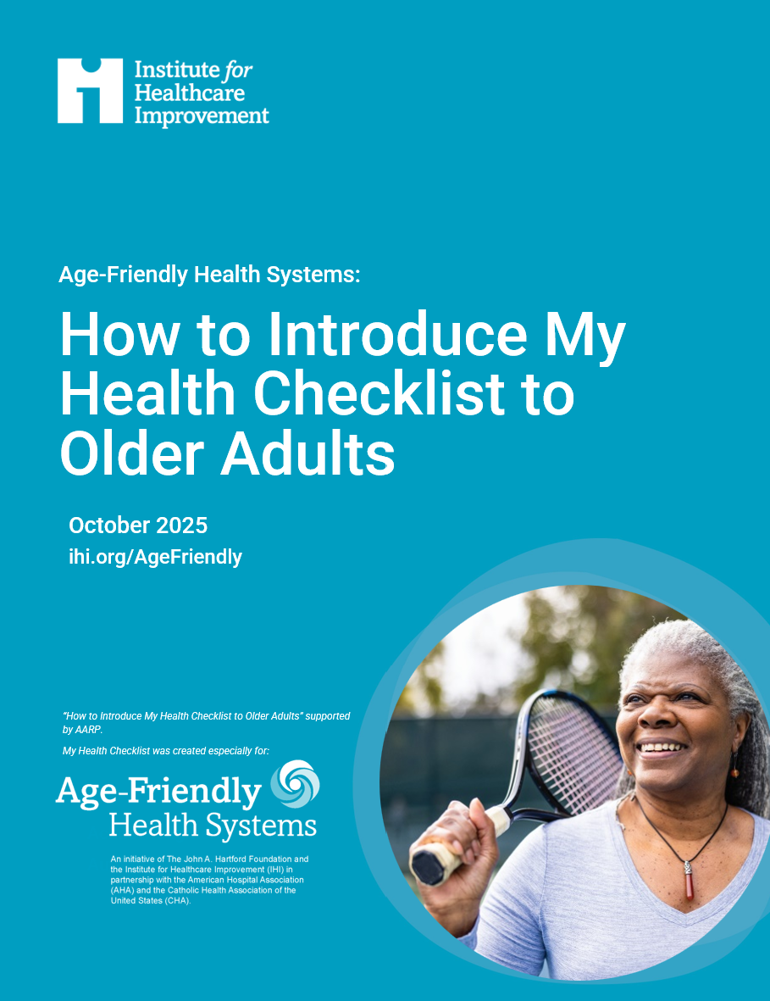
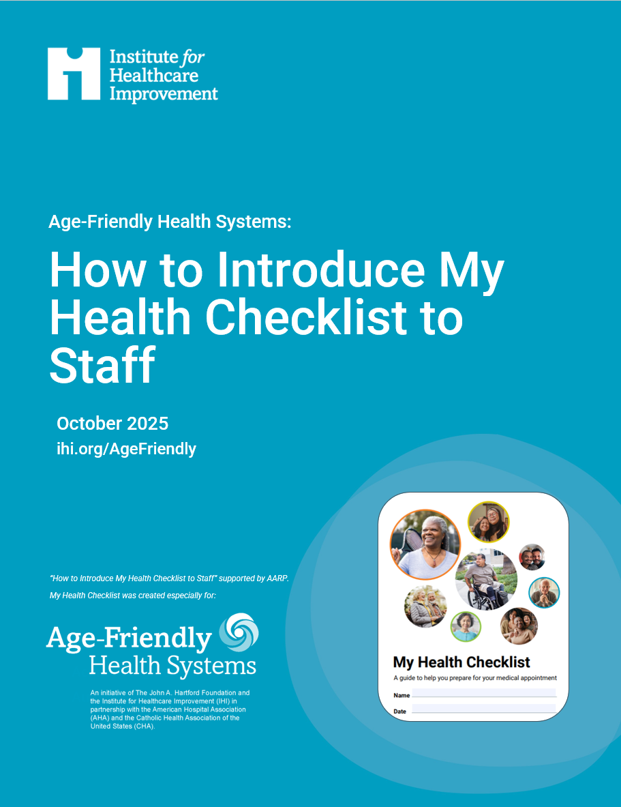
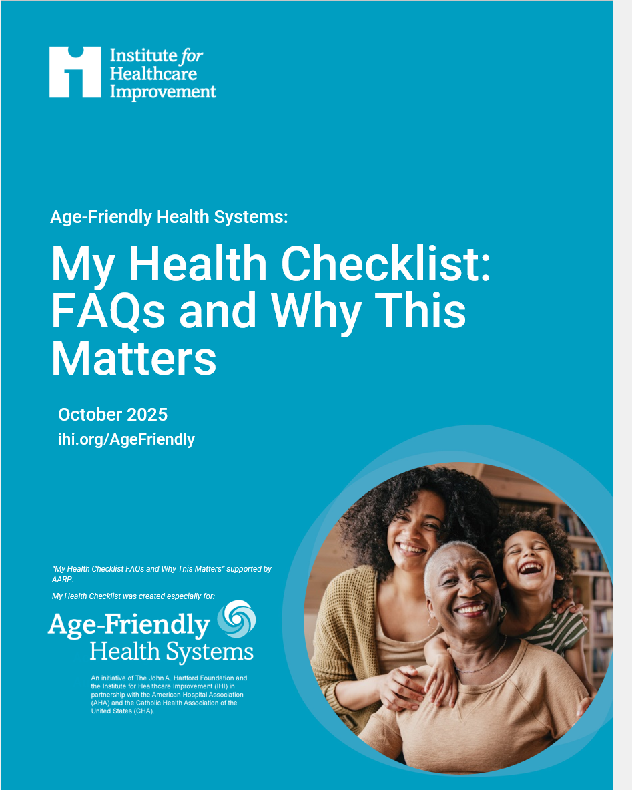
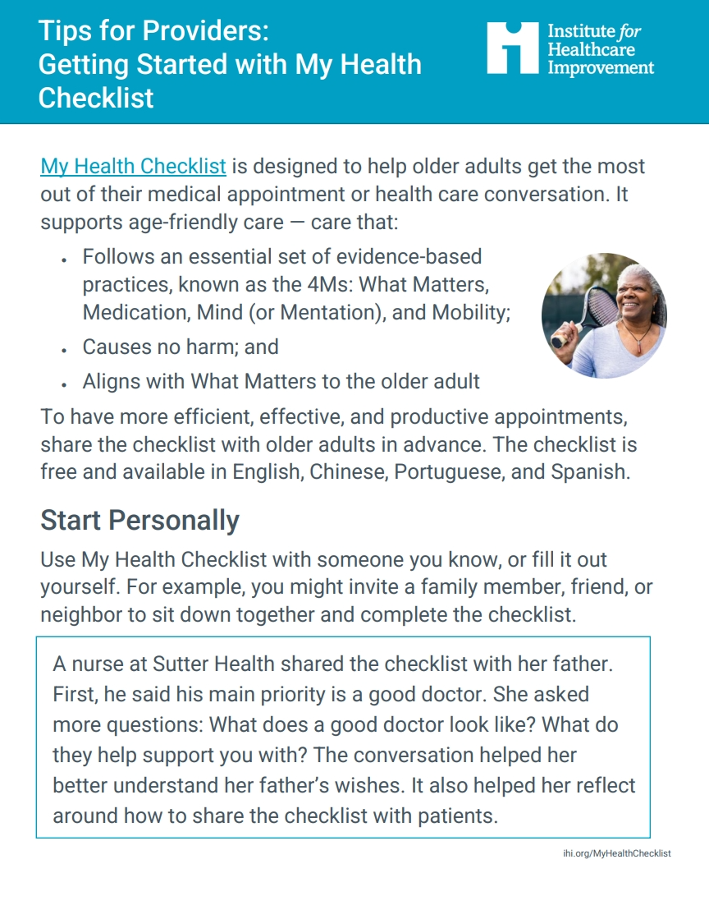
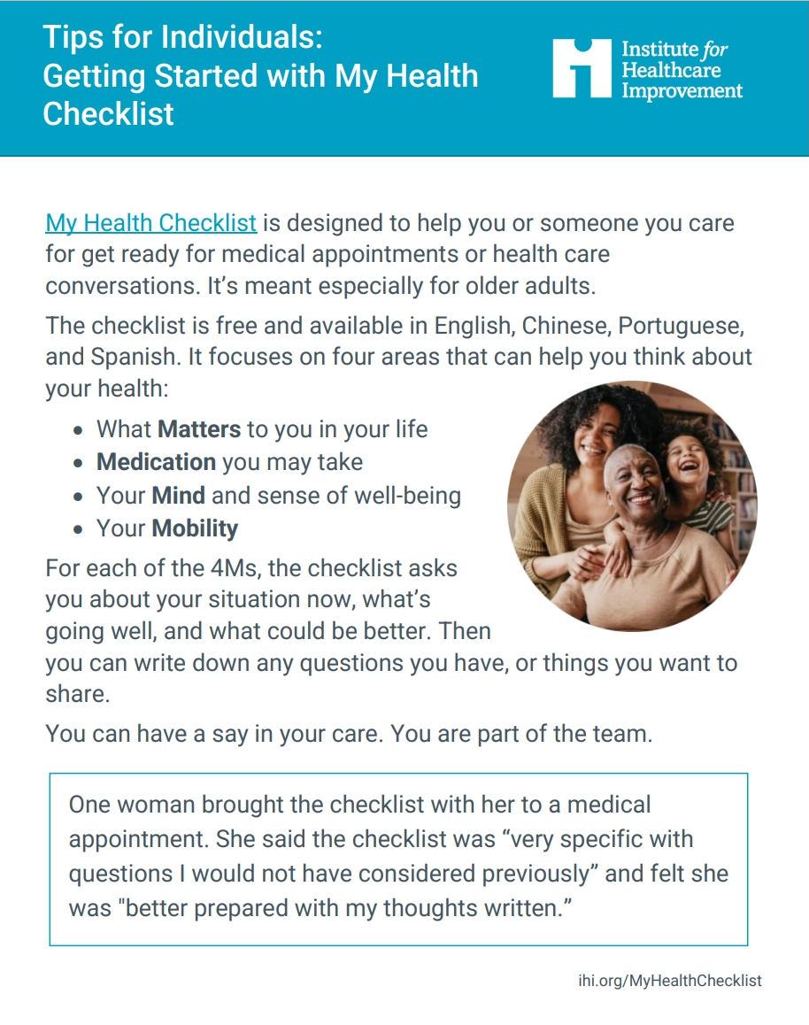
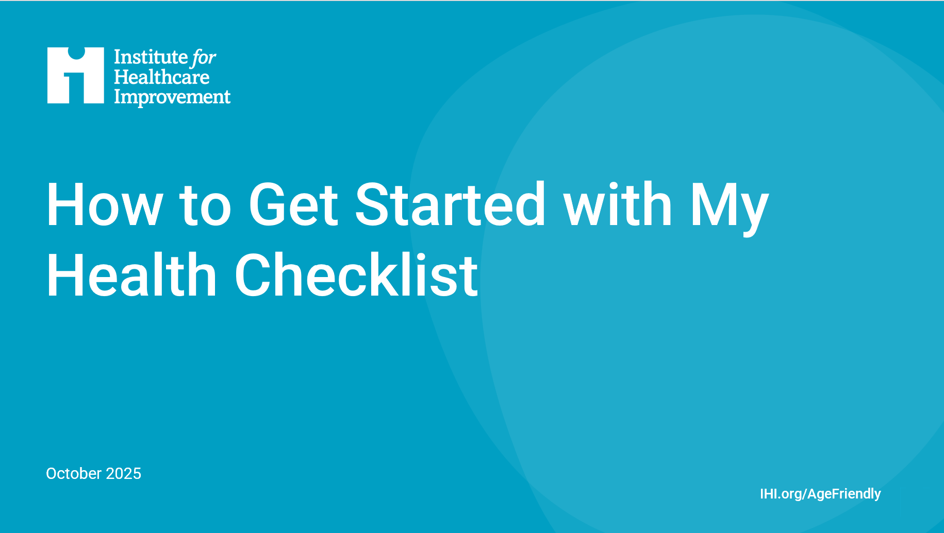
Notes:
Other resources:
At ihi.org/AgeFriendly you can find resources and guidance for sharing My Health Checklist
Watch these two videos of providers talking about how My Health Checklist supports meaningful conversations and better care

Slide 18
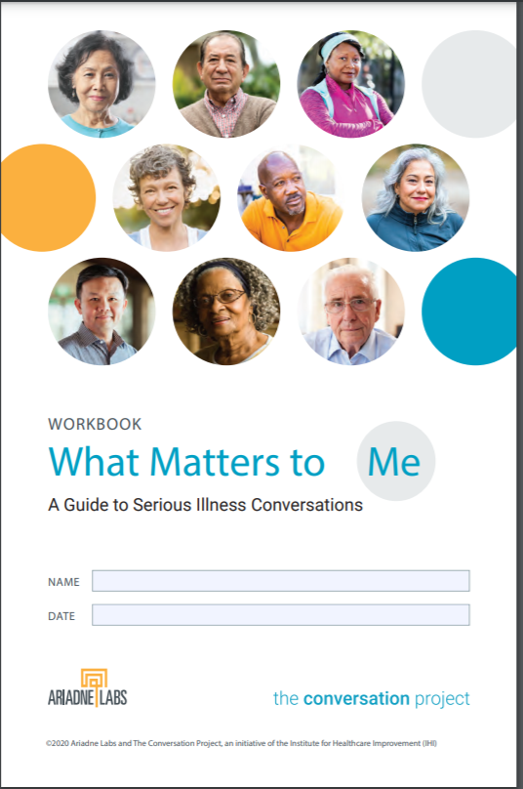
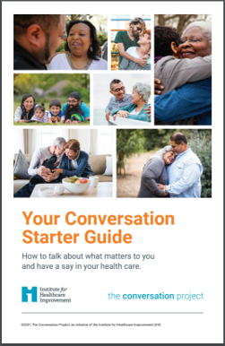
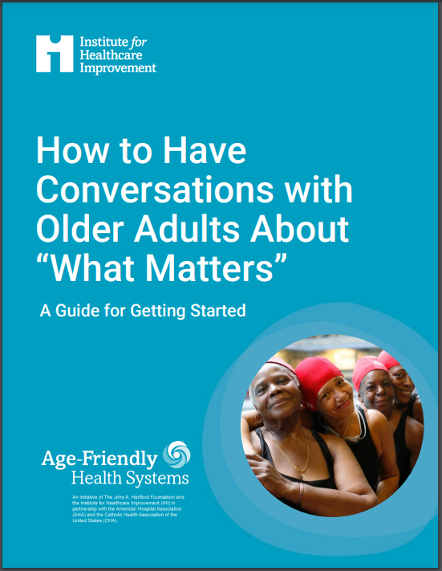
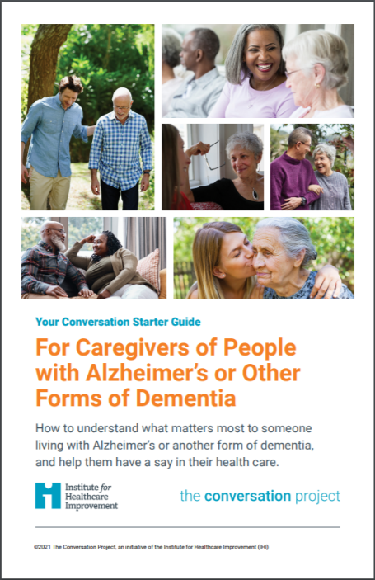
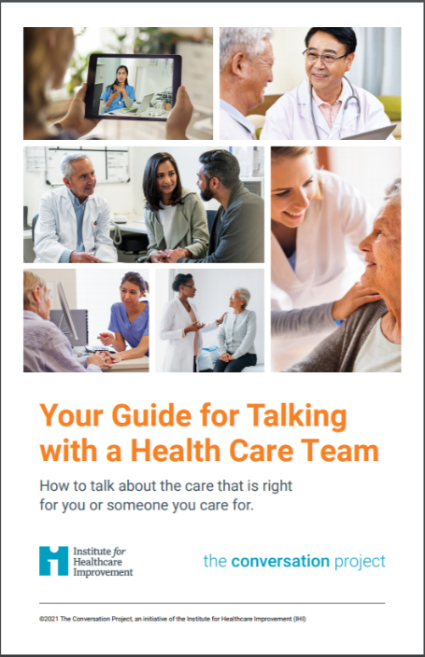
Other Resources
https://www.ihi.org/age-friendly-health-systems-resources-and-news
And more on www.theconversationproject.org
Notes:
Other resources:
IHI also has this guide on the left, which is provider focused, to help those who are unsure how to start
Direct link to guide: https://www.ihi.org/sites/default/files/2023-10/AgeFriendlyHealthSystems_How-to-Have-Conversations-with-Older-Adults-About-What-Matters.pdf
And The Conversation Project, IHI’s public engagement initiative to help people share their wishes for care through the end of life, has multiple guides for the general public, including older adults.
What Matters to Me is a workbook for anyone who has been diagnosed with a serious illness
Your Conversation Starter Guide is for anyone to think about and talk about wishes for care through end of life
For Caregivers of People with Alzheimer’s of Other Forms of Dementia is to help caregivers support these conversations with their person
And, Your Guide for Talking with A Health Care Team is to help individuals talk about what matters with their care team

Slide 19
Core Principles (from Conversation Ready )

Slide 20
Core Principles
Five core principles can help health care organizations and clinicians develop reliable processes to engage patients in conversations about their wishes, steward that information, and provide care that is concordant with patients’ stated goals, values, and preferences.
While the core principles were developed with a specific focus on what matters through the end of life, they still apply to the broad reach of age-friendly care. For more, see the "Conversation Ready" white paper.

Slide 21
Core Principles
Exemplify: Practice and model the behaviors we are encouraging others to undertake
Connect: Appreciating the context of older adults’ lives (and those who support them) and attend to our own biases
Engage: Be proactive about knowing what matters most to individuals
Steward: Collecting information on goals, values, and preferences. Consistently capture, store, maintain, and retrieve it.
Respect: Respectful care is concordant with individual’s stated goals, values, and preferences for what matters most to them.

Slide 22
Exemplify
Use My Health Checklist with an older adult you know, or fill it out yourself. For example, you might invite a family member, friend, or neighbor to sit down together and complete the checklist.
Kerri Maya shares that a colleague at Sutter Health used the checklist with her father. At first, he said that his main priority is to have a good doctor. She followed up by asking more questions: "What does a good doctor look like? What do they help support you with?" The conversation helped her better understand her father’s wishes. It also helped her reflect around how to educate patients about using the checklist.

Slide 23
Connect
Use the examples in the checklist to ask about the person’s life experiences, leading with cultural curiosity and humility. The examples are carefully crafted from feedback from older adults, caregivers, and health care team members, sharing a range of life experiences (such as retired or working, various income levels and housing needs, and different physical abilities). The goal is for anyone to be able to pick it up and think, “This could be for me”:
Examples include issues that people might hesitate to bring up on their own, including loneliness, treatments costing too much, bladder control, and relationships and intimacy. Wording does not make assumptions about gender, family relationships, or sexual orientation. Imagery and language reflect a variety of life experiences.

Slide 24
Engage
You might share the checklist:
By mail or electronically before a visit
Through a partnership with a community organization (e.g., library, senior center)
When someone is rooming the older adult, during an appointment, or during geriatric rounds
As part of print and/or electronic discharge materials (for example, transitioning from hospital to home, or from home health to primary care)
As part of a visit with social worker or other care team member supporting advance care planning
The older adult might bring the completed checklist to a follow-up appointment or primary care visit.

Slide 25
Steward
Document what matters to the older adult.
Write down what you learned in the conversation in the electronic health record or on paper. Use the person’s own words as much as possible (e.g., “I would like to be able to walk around the block” rather than “Patient wants to mobilize”).
Share this information with the care team. Make sure care teams members know where this information is stored and can access it

Slide 26
Respect
Integrate into the care plan. Then, review the care plan with the older adult to check if it aligns with what is important to them across the 4Ms. Adapt the plan if needed.
Connect and coordinate with care team members across professions and with community partners beyond your organization. For example, hold regular team huddles to talk about what matters to those you care for and develop the care plan accordingly.
Continue the conversation with these older adults. Remember, talking about the 4Ms is not a one-time conversation.
Ask for feedback. Strengthen relationships with all older adults. Spread what works.

Slide 27
Preparing for Conversations about Completed Checklists

Slide 28
Get Ready
You can gather some details from the medical record or team members, or ask the older adult directly. For example, find out:
How does the older adult prefer to be addressed (e.g., Izzy, Mrs. Morales, Mx. Smith, Omar)?
What is the older adult’s preferred language? Would they like a medical interpreter?
Would the older adult like a trusted individual to participate in the conversation, such as a friend, family member, or spiritual/faith advisor?
How can you practice kindness to build trust? For example, if the older adult is angry or upset, don’t get defensive — listen and acknowledge their experience.

Slide 29
Get Ready: Three Steps to Build Trust
1. Let the older adult know they can say anything.
“I welcome all your ideas and questions.”
2. Pay attention to their words and join them in advancing their goals.
“I'll listen and work with you on how we can address what’s important to you.”
3. Don’t claim to have all the answers. Do commit to working together.
“We'll figure this out together.”
Remember that any individual may choose not to have a conversation about What Matters.

Slide 30
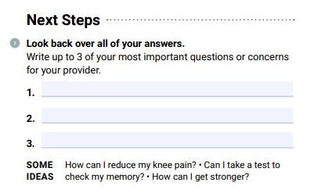
Start with Asking and Listening
When someone has completed the checklist, you might say:
“Thank you for taking the time prepare for our conversation. Let’s look at the last page with your top concerns. What are your most important questions for today?”
For more tips, download: How to Have Conversations with Older Adults About “What Matters”

Slide 31
Start with Asking and Listening
Try one of these questions to continue the conversation, or create your own:
Are there any concerns you would like to talk about?
What would make tomorrow a really great day for you?
Is anything getting in the way of doing the activities that you would like to do?
Would you like support with transportation, scheduling, or having someone else join this conversation next time we talk?
What else would you like us to know about you?

Slide 32
You Don’t Need to Have All the Answers
The person’s responses may be related to care, or they may not. Just by hearing What Matters to them, you’ll have information to help make better decisions with this individual.
You don’t personally have to solve every issue that comes up. If the person asks a question or makes a request and you’re not sure how to answer, say that you need to find out more and you will get back to them with an answer. Sometimes, other teams or even other organizations in the community can play a role in acting on What Matters. Remember to follow up with the person once you have more information — this is important to maintain trust
Read more: Social Prescribing Can Optimize Quality of Life and Age-Friendly Care

Slide 33
Next, Reflect
Ask yourself:
What can I do in this appointment to address these goals and integrate what is important to the older adult into the care plan?
With whom can I share this information (e.g., team members, referrals)?
How can I remember what I learned in this conversation when I talk with this person next?

Slide 34
Then, Write It Down
Document what is important to the older adult across the 4Ms.
Write down what you learned in the conversation in the electronic health record or on paper. Use the person’s own words as much as possible (e.g., “I would like to be able to walk around the block” rather than “He wants to mobilize”).
Share this information with the care team. Make sure care teams members know where this information is stored and access it

Slide 35
Take Action
Integrate into the care plan. Then, review the care plan with the older adult to check if it aligns with what is important to them across the 4Ms. Adapt the plan if needed.
Connect and coordinate with care team members across professions and with community partners beyond your organization. For example, hold regular team huddles to talk about what matters to those you care for and develop the care plan accordingly.
Continue the conversation with each older adult. Remember, talking about the 4Ms is not a one-time conversation.
Ask for feedback. Strengthen relationships with all older adults. Spread what works.

Slide 36
Sample Presentation

Slide 37
Instructions
Purpose: The following presentation is geared toward those looking to share the My Health Checklist with health care staff/providers to get them familiar with the checklist, why it’s important, and ways they can use it and share it with older adults (or those supporting an older adult).
Adapt: Feel free to adapt this to your audience. Suggested talking points are in the notes section.
Share a personal story: Consider starting by sharing a positive, motivational personal story of why this is important to you personally, or professionally

Slide 38
My Health Checklist
Your name, contact
Notes:
[Set the stage however you feel is right for your audience]
Sharing a resource today I hope will make our work with older adults easier.
Consider starting by sharing why this is important to you. Maybe you have an older adult in your own life who, when they are given the opportunity to share what is important to them, would feel better prepared by having a say in their care.

Slide 39
What staff and older adults want
What brings staff the greatest satisfaction in their jobs is being able to deliver ideal patient experiences.
Older adults want collaboration, kindness, and respect from their care team. And, to be active participants in their care.
99% of adults 50+ say that in the event of a serious illness, it’s important that What Matters be the primary consideration for their care.
Massachusetts Coalition for Serious Illness Care consumer experience and messaging research, 2019 and 2020–2021. http://maseriouscare.org/research
Locock L, Graham C, King J, et al. Understanding how front-line staff use patient experience data for service improvement: an exploratory case study evaluation. Southampton (UK): NIHR Journals Library; 2020 Mar. (Health Services and Delivery Research, No. 8.13.) Available from: ttps://www.ncbi.nlm.nih.gov/books/NBK554766/
The John A. Hartford Foundation, November 2023.
Notes:
We’ve learned a lot over these last years. Research shows:
What brings staff the greatest satisfaction in their jobs is being able to deliver ideal patient experiences
That adults want collaboration, kindness, and respect from their care team. And, to be active participants in their care
This starts with communication, two-way conversations
Exactly what the My Health Checklist is meant to foster
It’s a tool for older adults but equally for you all as providers or staff and I hope to show you why…..
IHI’s Age-Friendly Health Systems team got requests for this resource from health systems that wanted something to provide to older adults to help them feel ready for appointments
And, they got requests from individuals, older adults who wanted something geared toward them to help them feel prepared before they got to an appointment

Slide 40
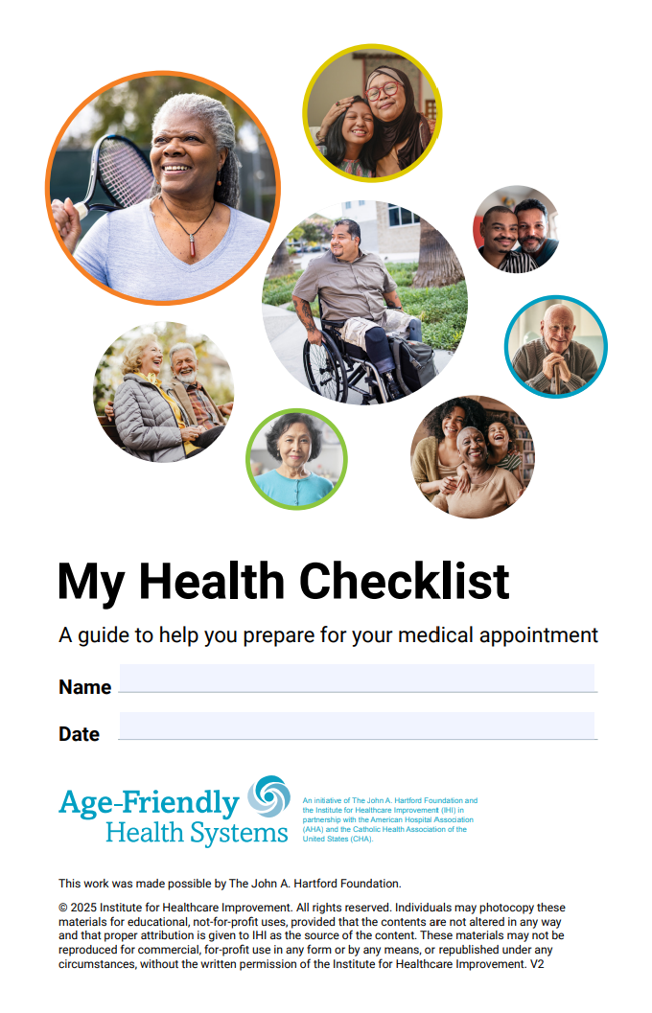
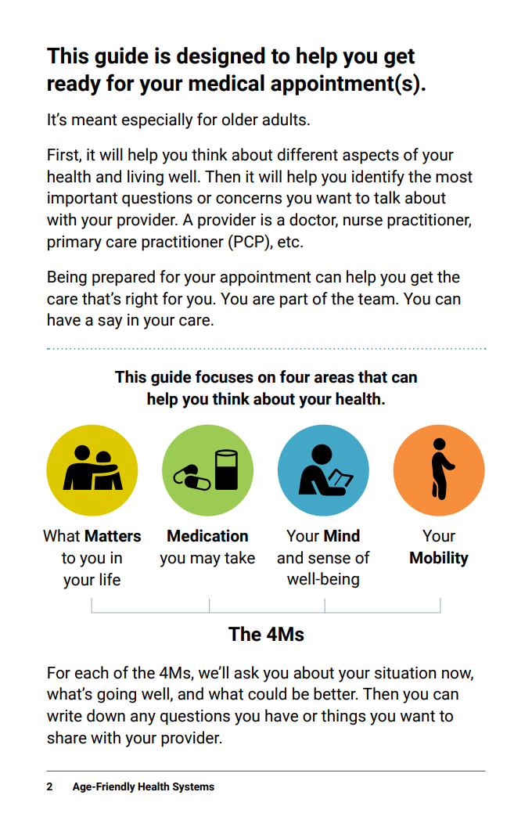
My Health Checklist
https://www.ihi.org/my-health-checklist
Notes:
Little background, what the tool is, isn’t, and its purpose, then jump into how you can use it
A comprehensive guide designed to help older adults reflect on their health and wellbeing, assessing all aspects of their health – and is centered on the 4Ms
Not meant to be a tool to be filled out at appointment time or take the place of any intake forms/questionnaire you (we) may already have (i.e. it’s not meant to be a health system-required form to fill out)
It’s a workbook for at-home use/self-reflection (wherever “home” may be) – to help older adults feel prepared to share at upcoming appts – some organizations have also found ways to use it before/during appointments:
they can review it on their own time, in pieces, when they are ready, and are really encouraged to take their time going through this (and with a family caregiver/support person if they have one, as noted in the checklist)
may help them be better prepped for any intake appointment materials you (we) have them do!
It can be filled out/updated for every appointment as we know wishes /health changes

Slide 41
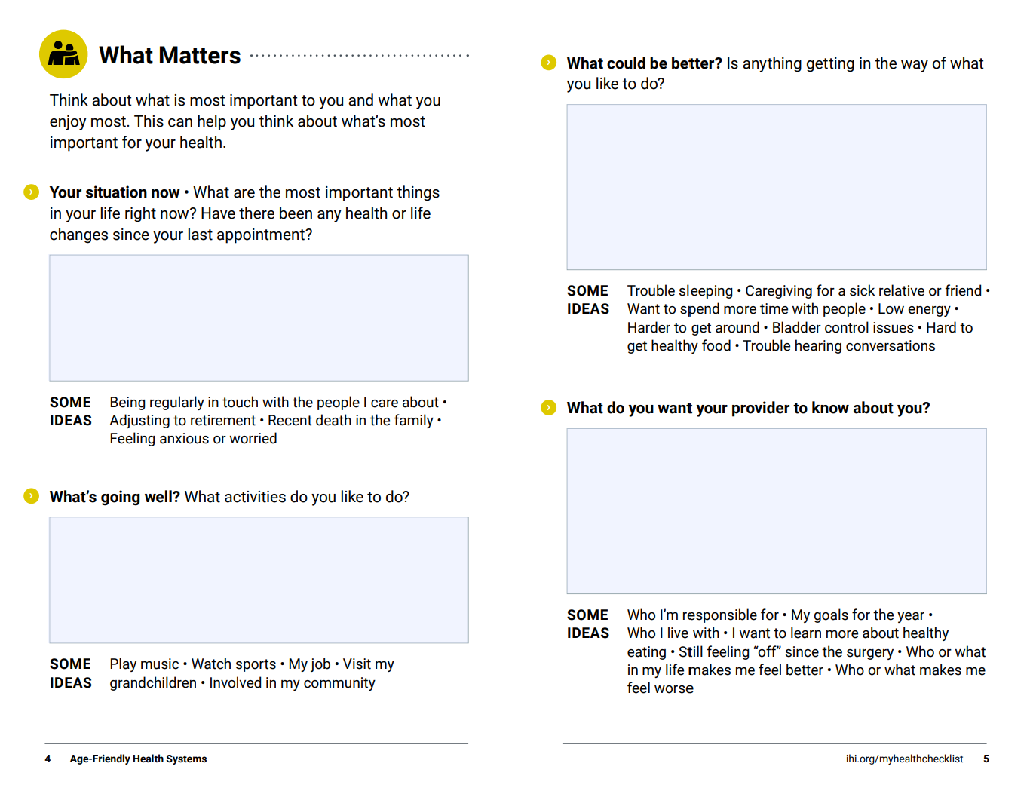
What Matters My Health Checklist
Notes:
The next four slides are just a quick look at each two-page spread so you can see what it would look like as printed workbook in someone’s hands and see the flow
Across all 4Ms – there are open ended, prompting questions to help older adults think about their situation now, what’s going well, what could be better, what they want their provider to know – questions or concerns
For each prompt – examples are shared (the “Some Ideas” under boxes) - very carefully crafted from feedback –sharing a range of life experiences. (e.g. retired or not, various income levels and housing needs, different physical ability levels, able bodied or more frail)
Checklist starts with and is grounded in What Matters
There is a similar spread for each of the 4Ms

Slide 42
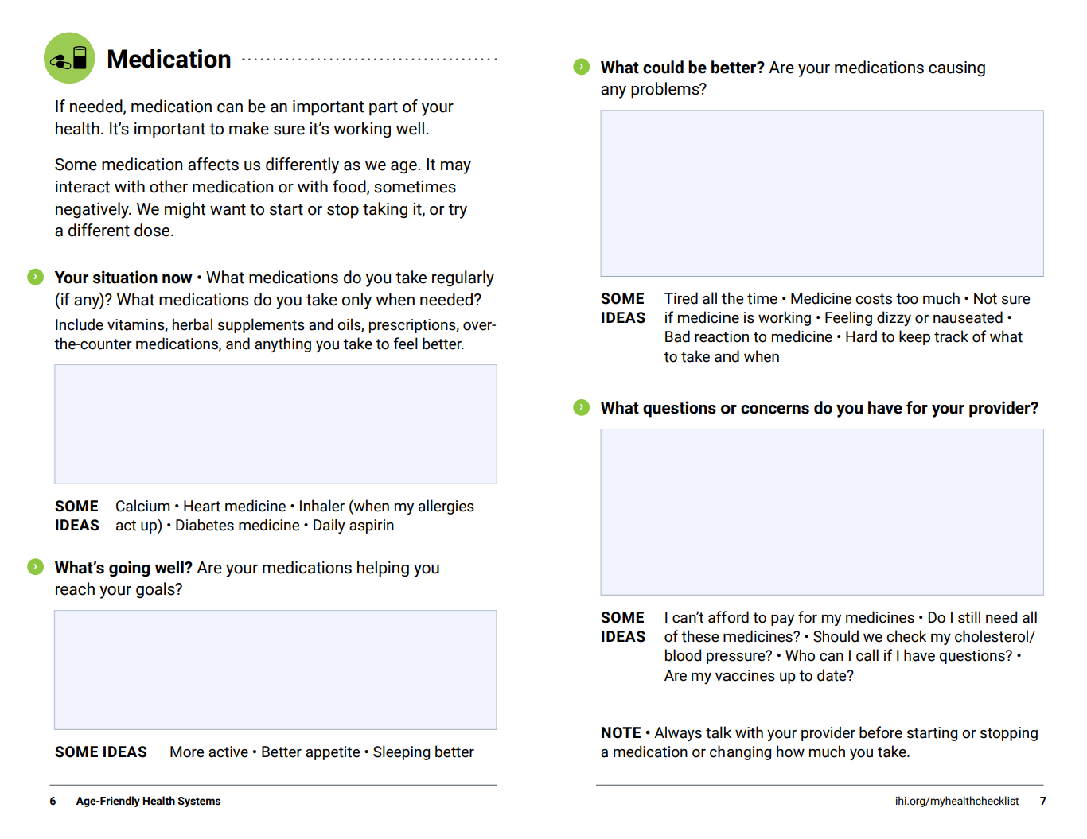
Medication My Health Checklist
Notes:
This spread supports important tasks like tracking medications but goes beyond just Rx

Slide 43
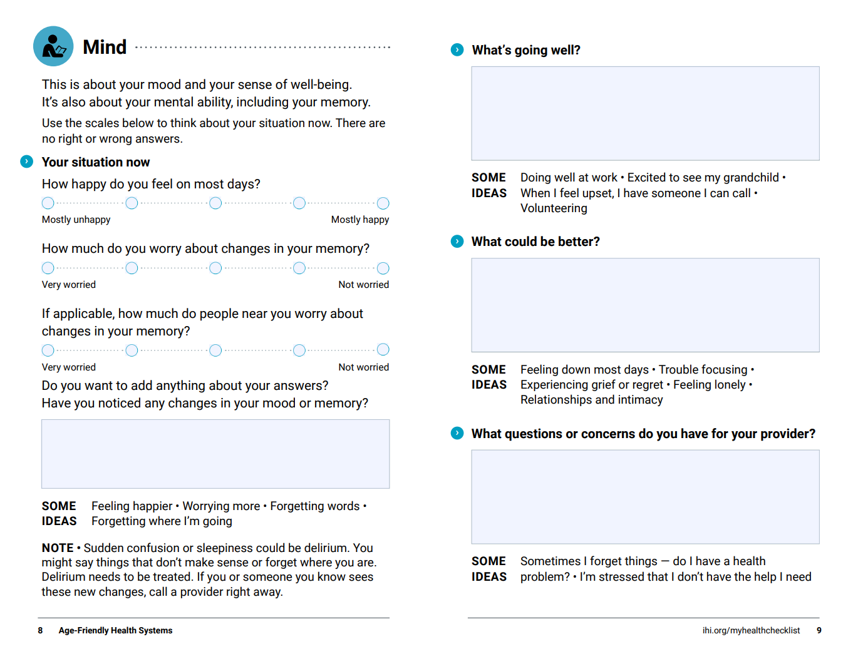
Mind My Health Checklist
Notes:
Talks about depressions/anxiety/loneliness/dementia

Slide 44
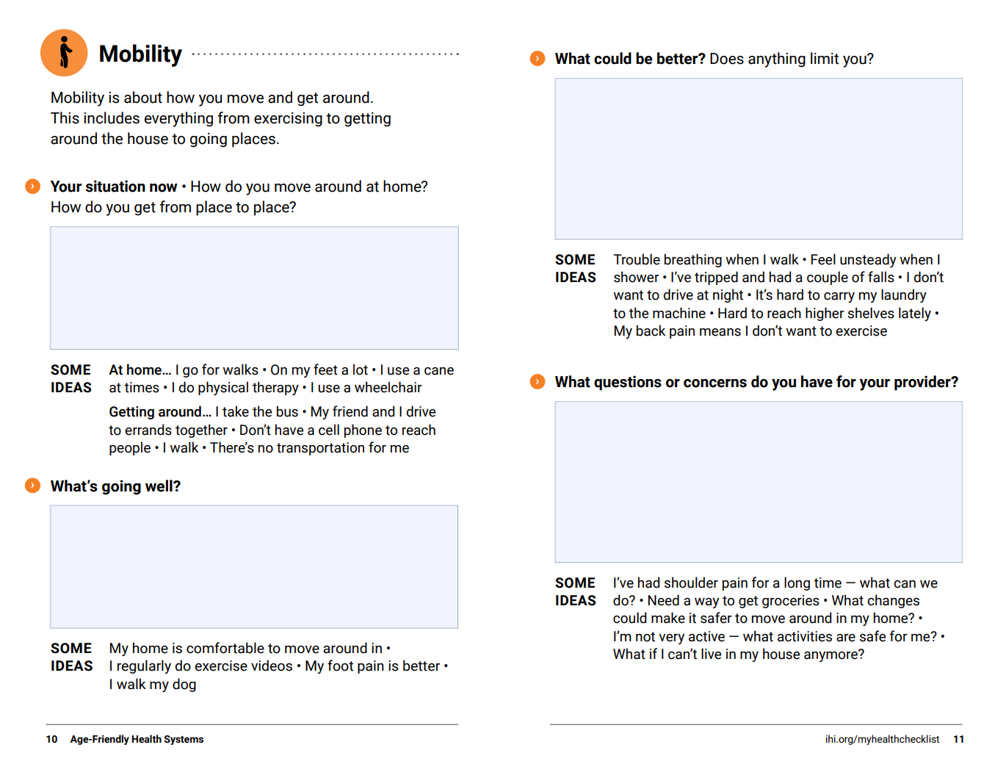
Mobility My Health Checklist
Notes:
Addresses mobility in the home and out

Slide 45
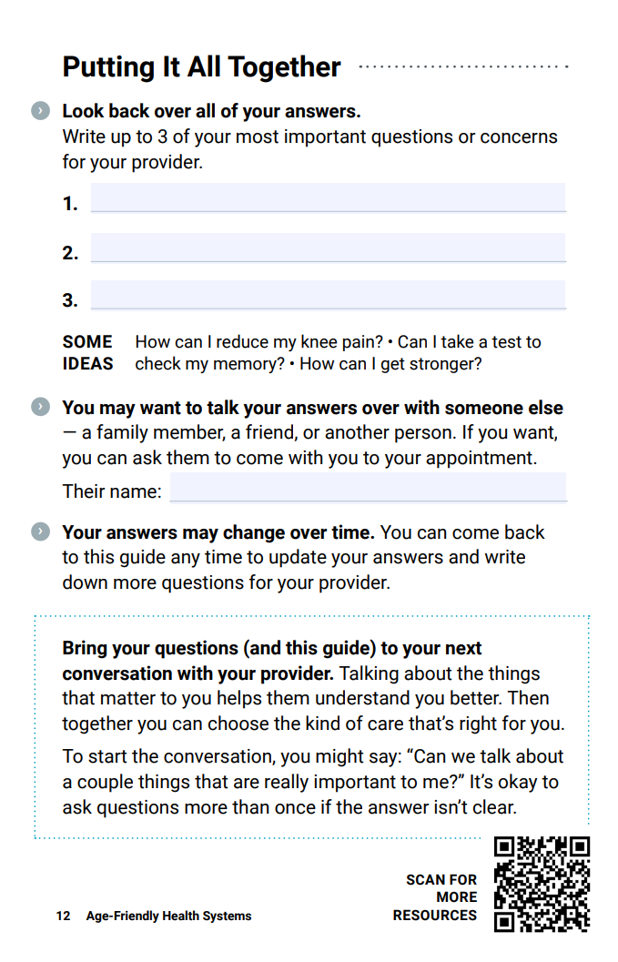
Next Steps My Health Checklist
Notes:
The last page serves as the “checklist” – where it’s suggested they pull it all together and bring up to 3 things important issues/questions with them to talk about at next appointment (recognizing time constraints providers have)
They may not want to fill every single page in (that’s OK!) - reviewing it can help prompt them to think and hone in on what matters to them
NOTE: A little on the development of the checklist, so your audience recognizes other important considerations to older adults:
IHI wanted anyone to pick this checklist up and think “this could be for me”
Throughout the checklist…
Addresses issues that might feel embarrassing but once you see it offered, gives permission to “go there” - examples talk about loneliness, can’t afford things, bladder control, relationships and intimacy
No gender-binary language used, no heteronormative assumptions about relationships, and included is language and imagery that is reflective of as many types of life experiences as possible
Checklist was co-designed with older adults, those supporting/caring for an older adult personally, and experts in Age-Friendly Health Systems:
input at start, across several iterations; a first draft of the printed booklet was discussed with focus groups (low/middle income/mixed demographics – one for older adults, one for caregivers)
Reviewed for changes/overwhelming positive feedback – they wanted to use it right away and share it
Multiple languages available: Spanish, Portuguese, and Chinese

Slide 46
Prioritizing these conversations around care can lead to...
…Better care alignment
…Better outcomes, high-quality care
…Trust and relationship building
…More activated/prepared older adults
…Better communication/connection between older adults and the health care team
Notes:
Why is this important?
Better care alignment - Understanding and responding to what truly matters to older adults is paramount to delivering effective care. By asking about and acting on their specific goals and preferences across all of the 4Ms – healthcare providers can align care with individual needs
We can achieve better outcomes by aligning care to What Matters most to those we care for
These conversations build trust and better relationships. The cornerstone of ALL care
Can help older adults/caregivers be more activated/prepared: Messaging research over last few years in the Advance Care Planning, palliative and hospice space shows when patients felt heard, listened to and asked about what’s important TO them– they feel better in control, More activated
[Reemphasize] these conversations help support better communication and connection between individuals and the health care professionals who care for them (an important dyad)

Slide 47
How can providers use the resource? Some examples
Personally
Share it with staff/internally: Lunch and learn, Grand rounds, etc.
Direct to older adults:
Inpatient care: hard copies in discharge packets, prep for next appt
Outpatient: in GP offices, annual Medicare or wellness visit materials, in specialist office, minute clinics
Long-term care settings: someone living with serious illness, or relatively healthy needing assistance with ADLs
Home care: in advance of home visits
Electronic communications: Newsletter, other email send outs, patient portals
Direct to community groups:
Co- host an event in the community
Tap into special DAYS/months: What Matters to You (#WMTY) Day, National Healthcare Decisions Day (#NHDD)
Notes:
Personally – take off professional hat – maybe you have older adult in your life (or it’s you!). Share it with that person. Great way to say, hey, I just did this or my parent just went through this checklist
Read through remaining bullets – adding your own examples or ideas
Good to note, there is no wrong way to introduce this – depends on who you want to reach and your goal for doing it!

Slide 48
Where/how older adults would like to receive My Health Checklist
Hospitals, doctor offices – in waiting rooms, information packets, wellness packets
Medicare: provide checklists to all enrollees
Health insurance company send outs
Community-based health fairs
Meals on wheels (or similar services)
Trusted leaders: faith leaders, etc
Libraries
AARP
Senior centers, Local areas on aging
Distribution system like COVID tests
Places family caregivers/support people gather
Notes:
In addition to the places we just talked about --- older adults IHI worked with had ideas of WHO in your community you could work with to get this into the hands of older adults. It’s not just up to you!
Review list of bullets, additional points below for some of the items in list:
Medicare/health insurance companies: provide checklists to all enrollees (they often send out info to enrollees, newsletters)
Senior centers: find corporations who run senior centers or assisted living centers (or other care sites/homes) – and have them distribute it to all their sites
Do some sort of distribution system like COVID tests: come get your free checklist here (e.g. call this number to get your two free My Health Checklists sent to you)
Places family caregivers/support people may be:
Support groups (online or in person)
Social media for younger caregivers
Share with local caregiver organizations
*Older adults in focus groups and involved in development noted printed checklists most desirable
Cautions:
Portals: remember not all are tech savvy – All have different abilities to absorb info or tech abilities – that changes quickly
Not all have computers or internet access

Slide 49
Using My Health Checklist to align care with What Matters
Starts with asking and listening
Then ask yourself:
What can I do in this appointment to address these goals and integrate What Matters into the care plan?
With whom can I share this information (e.g., team members, referrals)?
How can I remember what I learned in this conversation when I talk with this person next?
Notes:
How providers can use the guide to align care with What Matters/patient-centered care?
Starts with asking and listening
Use content in the checklist as prompts for starting a conversation with your next patients/older adult!
Ask yourself:
What can I do in this appointment to address these goals and integrate What Matters into the care plan?
With whom can I share this information (e.g., team members, referrals)?
Think about who you may share this with across the continuum - other care teams and settings that may need to hear what you are learning
How can I remember what I learned in this conversation when I talk with this person next?
Include what you learned in your clinical notes. See if your org has a template to capture these convos in EHR, like an advance care planning note
Example: one system who is part of AFHS uses a smart phrase in the sticky note section of EPIC – prompting to ask what’s important to them, when the patient discharges, the note disappears, this way they must ask the question on each admission as what matters may change over time. They also capture what’s important to the patient with additional questions added to their advance care planning form. They capture what matters related to social or emotional (grandkids wedding, being able to have weekly lunch out with daughter) as well as physiologically (EOL decisions)

Slide 50
Using My Health Checklist to align care with What Matters
Next, take action
Review the care plan with the older adult to check if it aligns with what matters
Ask for feedback
Strengthen relationships with all older adults
Spread what works
Notes:
Review the care plan with the older adult to check if it aligns with what matters
If needed, adapt the care plan
Connect and coordinate with care team members across professions and community partners to address older adult preferences and needs (e.g. if they are in need of transport or food access concerns, connect with social services/social worker on your team)
You might hold regular team huddles with other team members and develop care plans accordingly together
Ask for feedback
Ask older adults what went well and what could go better. Survey them to see how well their care matches what matters to them
Use this to Strengthen relationships with all older adults
Acknowledge out loud with older adults that many people lack trust in the care system. Talk about these issues with colleagues in the context of your community. Ask every older adults about what matters/4Ms, not only those who look like or talk like you or who you feel most comfortable with
Spread what works
Identify and act on common responses. For example, if many older adults say they get hungry at night after the cafeteria closes, work with the dining facilities team to create a late-night food option
End results: Shows you care about them as people (not just as a patient) – builds relationships; helping them take control

Slide 51
Other Resources
Resources from AARP, including two videos of providers talking about how shared decision-making leads to more meaningful care and engaging the community with the 4Ms
Notes:
If you want to share other resource:
Watch these two videos of providers talking about how My Health Checklist supports meaningful conversations and better care

Slide 52
Notes:
If you want to share other resources:
At ihi.org/MyHealthChecklist you can find resources and guidance for sharing My Health Checklist

Slide 53
Other Resources
https://www.ihi.org/age-friendly-health-systems-resources-and-news
And more on www.theconversationproject.org
Notes:
If you want to share other resources:
IHI also has this guide on the left, which is provider focused, to help those who are unsure how to start
Direct link to guide: https://www.ihi.org/sites/default/files/2023-10/AgeFriendlyHealthSystems_How-to-Have-Conversations-with-Older-Adults-About-What-Matters.pdf
And The Conversation Project, IHI’s public engagement initiative to help people share their wishes for care through the end of life, has multiple guides for the general public, including older adults.
What Matters to Me is a workbook for anyone who has been diagnosed with a serious illness
Your Conversation Starter Guide is for anyone to think about and talk about wishes for care through end of life
For Caregivers of People with Alzheimer’s of Other Forms of Dementia is to help caregivers support these conversations with their person
And, Your Guide for Talking with A Health Care Team is to help individuals talk about what matters with their care team

Slide 54
Stories – First Impressions

Slide 55
From an Older Adult
At Bridgeport, Melissa Hanson received feedback from a few older adults. They thought the length of the checklist was appropriate and easy to navigate.
One older adult who brought the checklist with her to an appointment said the checlist was "very specific with questions I would not have considered previously" and felt she was "better prepared with my thoughts written.”

Slide 56
From Older Adults
A husband and wife learned about My Health Checklist at a geriatric conference. The wife has dementia but was still able to give feedback. Her husband is her advocate and caregiver.
He liked the sections of the checklist, which let them fill out just the sections they need. He said it felt respectful of their time.
Putting people on the spot doesn't allow them to think about questions enough, so the checklist would help them to reflect and prepare.

Slide 57
From the Daughter of an Older Adult
“I finally had some time to look through the checklist, and my overall opinion is that it’s a fantastic tool for older adults and their caregivers/helpers!
“I think the four categories are excellent (“the 4Ms”), and encompass all pertinent areas of importance in terms of what most older people want/need to speak to their physicians about during an appointment. So often the conversation gets off track from the get-go and it is like chasing the wind, and critical concerns often get missed. This booklet would go a long way towards helping seniors organize their thoughts before seeing a provider. I think it would greatly help guide the provider as well.”
“Many seniors do have the knowledge to [go online to get the material], but so many do not nor do they have a younger more tech-savvy helper. I realize computers and technology continue to be the way we get things done, but there are still older adults who are perhaps tech challenged or visually impaired who need things available to them in an alternate format without having to jump through more computer hoops.”

Slide 58
Stories — Using the Checklist

Slide 59
From an Older Adult
“The brochure was beneficial in helping me formulate my questions in advance of my appointment. In addition, right after [the conversation about My Health Checklist] I called and requested that I have an X-ray on my foot in advance of seeing my doctor. The X-ray revealed that the surgery on my right foot… had not healed correctly, indicating shifting of the screw implants. This is only now being discovered, nine months after surgery, and a corrective surgery is required... I am wearing a boot until then.
“The guide gave me the initiative to request the X-ray because I felt something was not right. In addition, I will insist on routine monitoring…
“During my previous visits, my foot was examined but not X-rayed, instead it was suggested I buy expensive shoe inserts to help with swelling and numbness. However, had X-ray monitoring occurred early on, corrective measures outside of repeat surgery might have been an option, and by the way, the inserts, a wasted expense.”

Slide 60
From an Older Adult
“I am so glad my daughter shared the checklist with me. When I was recently admitted through the ED [emergency department], my nurse said that I was the most prepared patient she ever had. My Health Checklist helped me articulate my meds, needs and preferences. I was so organized that she didn’t believe I was 83!" —Ireland Hawkins

Slide 61
From a Clinician-Leader from New Mexico
“The Care Navigators utilize the My Health Checklist as a resource for our clients [family caregivers]. To build and concretize our processes and services for our clients, we created and continue to build a collection of what we term, ‘Care Navigation session templates.’ Currently, My Health Checklist and The Conversation Project are included in our Care Navigation session template for ‘Communication.’
“We discuss the resources with the clients and as a follow up, email the language below and attach pdfs…
“My Health Checklist is a guide designed to help older adults get the most out of their medical appointments. This guide may help your (care recipient) think through all aspects of their health — what’s going well, what could be better, and your questions or concerns. Think of this guide as a tool to have open conversations with your (care recipient) about their care needs and to help them realize that you are here to help.”

Slide 62
From a Caregiver and Nurse
At Sutter Health, one team member who is a nurse used the checklist with her father. He has some mild cognitive issues and had several recent medical events. It took some prompting to help him understand the purpose of the checklist.
At first, when asked what mattered to him in his health care, he said that his main priority is to have a good doctor. She followed up by asking more questions: What does a good doctor look like? What do they help support you with?
The conversation helped her better understand her father’s wishes, and also helped her reflect around how to educate patients about using the checklist.

Slide 63
From a Health Care Professional
"I am getting requests from various colleagues and direct reports for use with their family members or loved ones. For example, one of my direct reports has a father that has fallen twice in the last week yet was refusing any mobility interventions. I suggested that perhaps the first step would be to understand what matters most to their father, what do they perceive is going well, and what could be better. By engaging in shared decision making, as opposed to simply being directive about what should be done to support mobility, the hope is that the father will feel more empowered."

Slide 64
Acknowledgements
Thank you to the older adults, family and caregivers, health care team members, and age-friendly experts who have engaged in this work.
Thank you to AARP for supporting this work to support the use of My Health Checklist.
The development of My Health Checklist was made possible by The John A. Hartford Foundation, a private, nonpartisan, national philanthropy dedicated to improving the care of older adults. For more information, visit www.johnahartford.org.

Slide 65
Acknowledgements
The advice and stories in this resource have been gathered from the work of IHI and Age-Friendly Health Systems in partnership with the following organizations leading the way to learn from the use of My Health Checklist: Atlantic Health Systems, Bayhealth: Sussex Campus and Kent Campus, Case Western University, Erie County Medical Center, HealthPartners: Hudson Hospital and Clinic, JPS Health Network, The Peter Lamy Center on Drug Therapy and Aging at University of Maryland School of Pharmacy, Medstar Health, Parkview Health, Sarasota Memorial Health Care System, Sutter Health, Mann Grandstaff Veterans Affair Medical Center (VAMC), West Tennessee Healthcare: Bolivar Hospital, Yale New Haven Health: Bridgeport Hospital and Milford Campuses.
Learn more about My Health Checklist and Age-Friendly Health Systems at ihi.org/AgeFriendly.

