Slide 1
Identify and Document Caregivers of Older Adults: How to Get Started
April 2026
ihi.org/AgeFriendly

Slide 2
What's in Here
Click to jump to any section:
About These Slides
Tips to Identify and Document Caregivers of an Older Adult
Tools and Resources
Case Examples | Scenario
Testimonials
Sample Tools from Sites
Definitions

Slide 3
About These Slides
Tips to Identify and Document Caregiver(s) of an Older Adult
is an Age-Friendly Health Systems resource, developed by IHI and made possible through funding from The John A. Hartford Foundation.
Learn more at ihi.org/AgeFriendly.
These slides contain tips and ideas for identifying and documenting caregivers(s) of an older adult.
Skip around and use them in any order.
You're welcome to use
these slides for your
own presentations.
The notes section has suggested talking points.

Slide 4
Acknowledgements
Brittany Jackson and Libby Hoy, PFCC Partners
Clara Park and Anna Chodos, CAP-CT
Diane Mariani and the Rush University Caring for Caregivers (C4C) team
Emily Simmons, University of Alabama at Birmingham
Felicia Cruz, Bayhealth
Jennifer Wolff, Johns Hopkins Bloomberg School
of Public Health
Karen Preston, AdventHealth Hendersonville
Khadeja Kausar, Maimonides Medical Center
Lauren Southerland, The Ohio State University Medical Center
Marie Cleary Fishman, American Hospital Association
Rosie Bartel
Taylor McMahon, Presbyterian Senior Care
What Matters to Older Adults Advisory Group
Special thank you to the
health care sites, supporting organizations, older adults, and caregivers who contributed to this work.

Slide 5
Tips to Identify and Document Caregivers of an Older Adult
Notes:
NOTE: The following slides offer a sample presentation that can be used to “make the case” when sharing this idea with others. Please feel free to adapt and use what’s useful for your purposes.

Slide 6

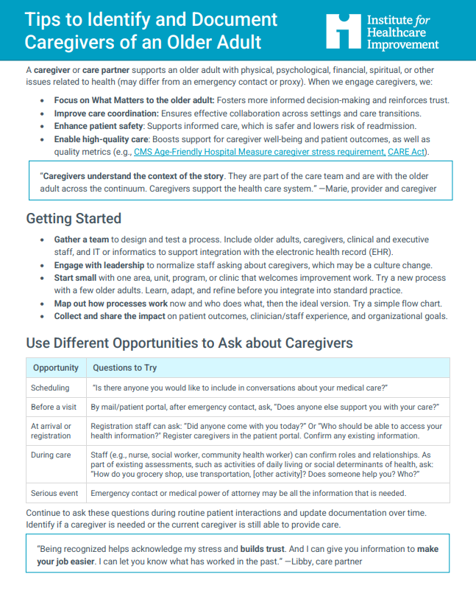
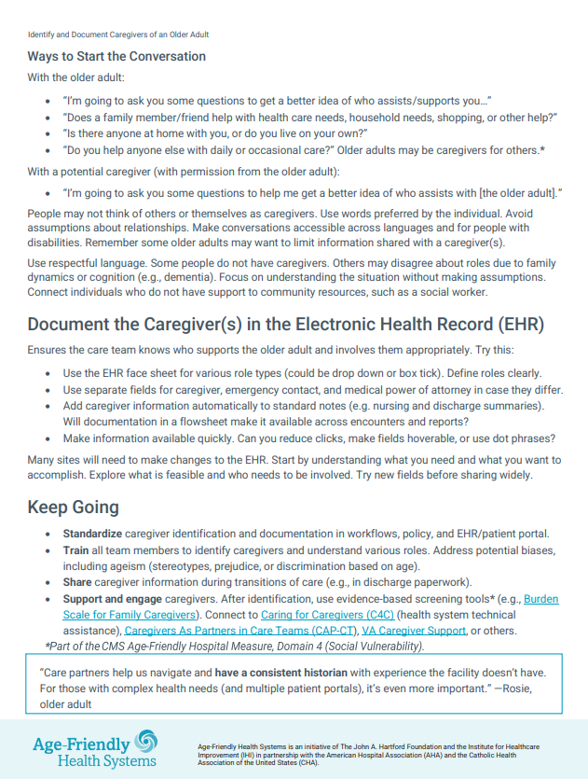
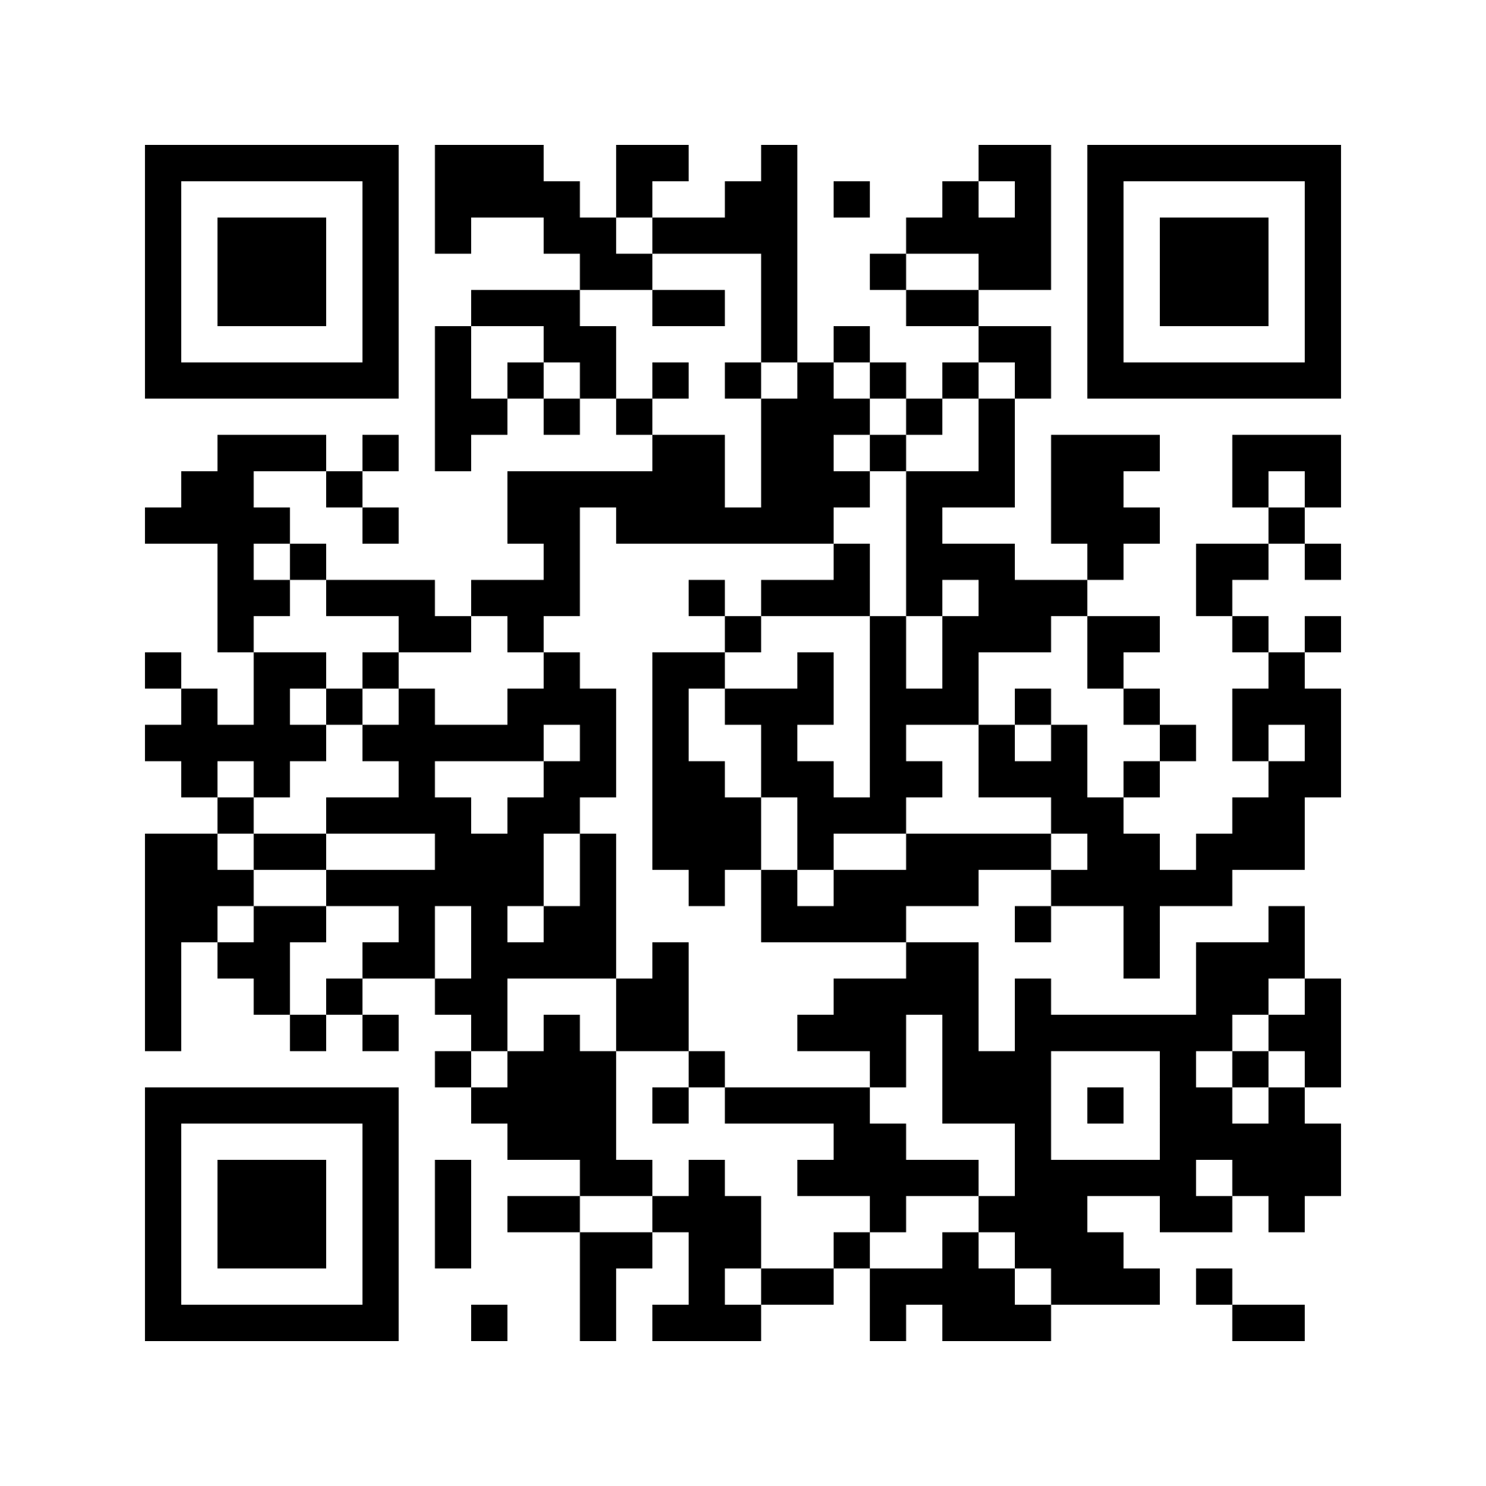
Scan to download
Identify and Document Caregivers of an Older Adult
Notes:
Possible talking points:
IHI has created a one-page handout to help delivery sites take actionable steps to identify and then document caregivers of an older adult. I’m going to walk you through what we can do and why this matters.

Slide 7

Context
A caregiver or care partner
supports an older adult with physical, psychological, financial, spiritual, or other issues related to health (may differ from an emergency contact or health care proxy/medical power of attorney).
Notes:
Possible talking points:
Listen to and use the language common in your community and by the older adult when talking about “caregiver”.
Some consider themselves more of a caring partner to the older adult so call themselves care partners rather than caregivers. One older adult and care partner notes the difference as: “Patients are supported by their caregivers. Care partners advise and advocate for and about patient care with healthcare professionals and patients.”
*See slide 45 for definitions and clarity on the role of health care proxy/medical power of attorney vs. emergency contact vs. next of kin to help educate staff

Slide 8
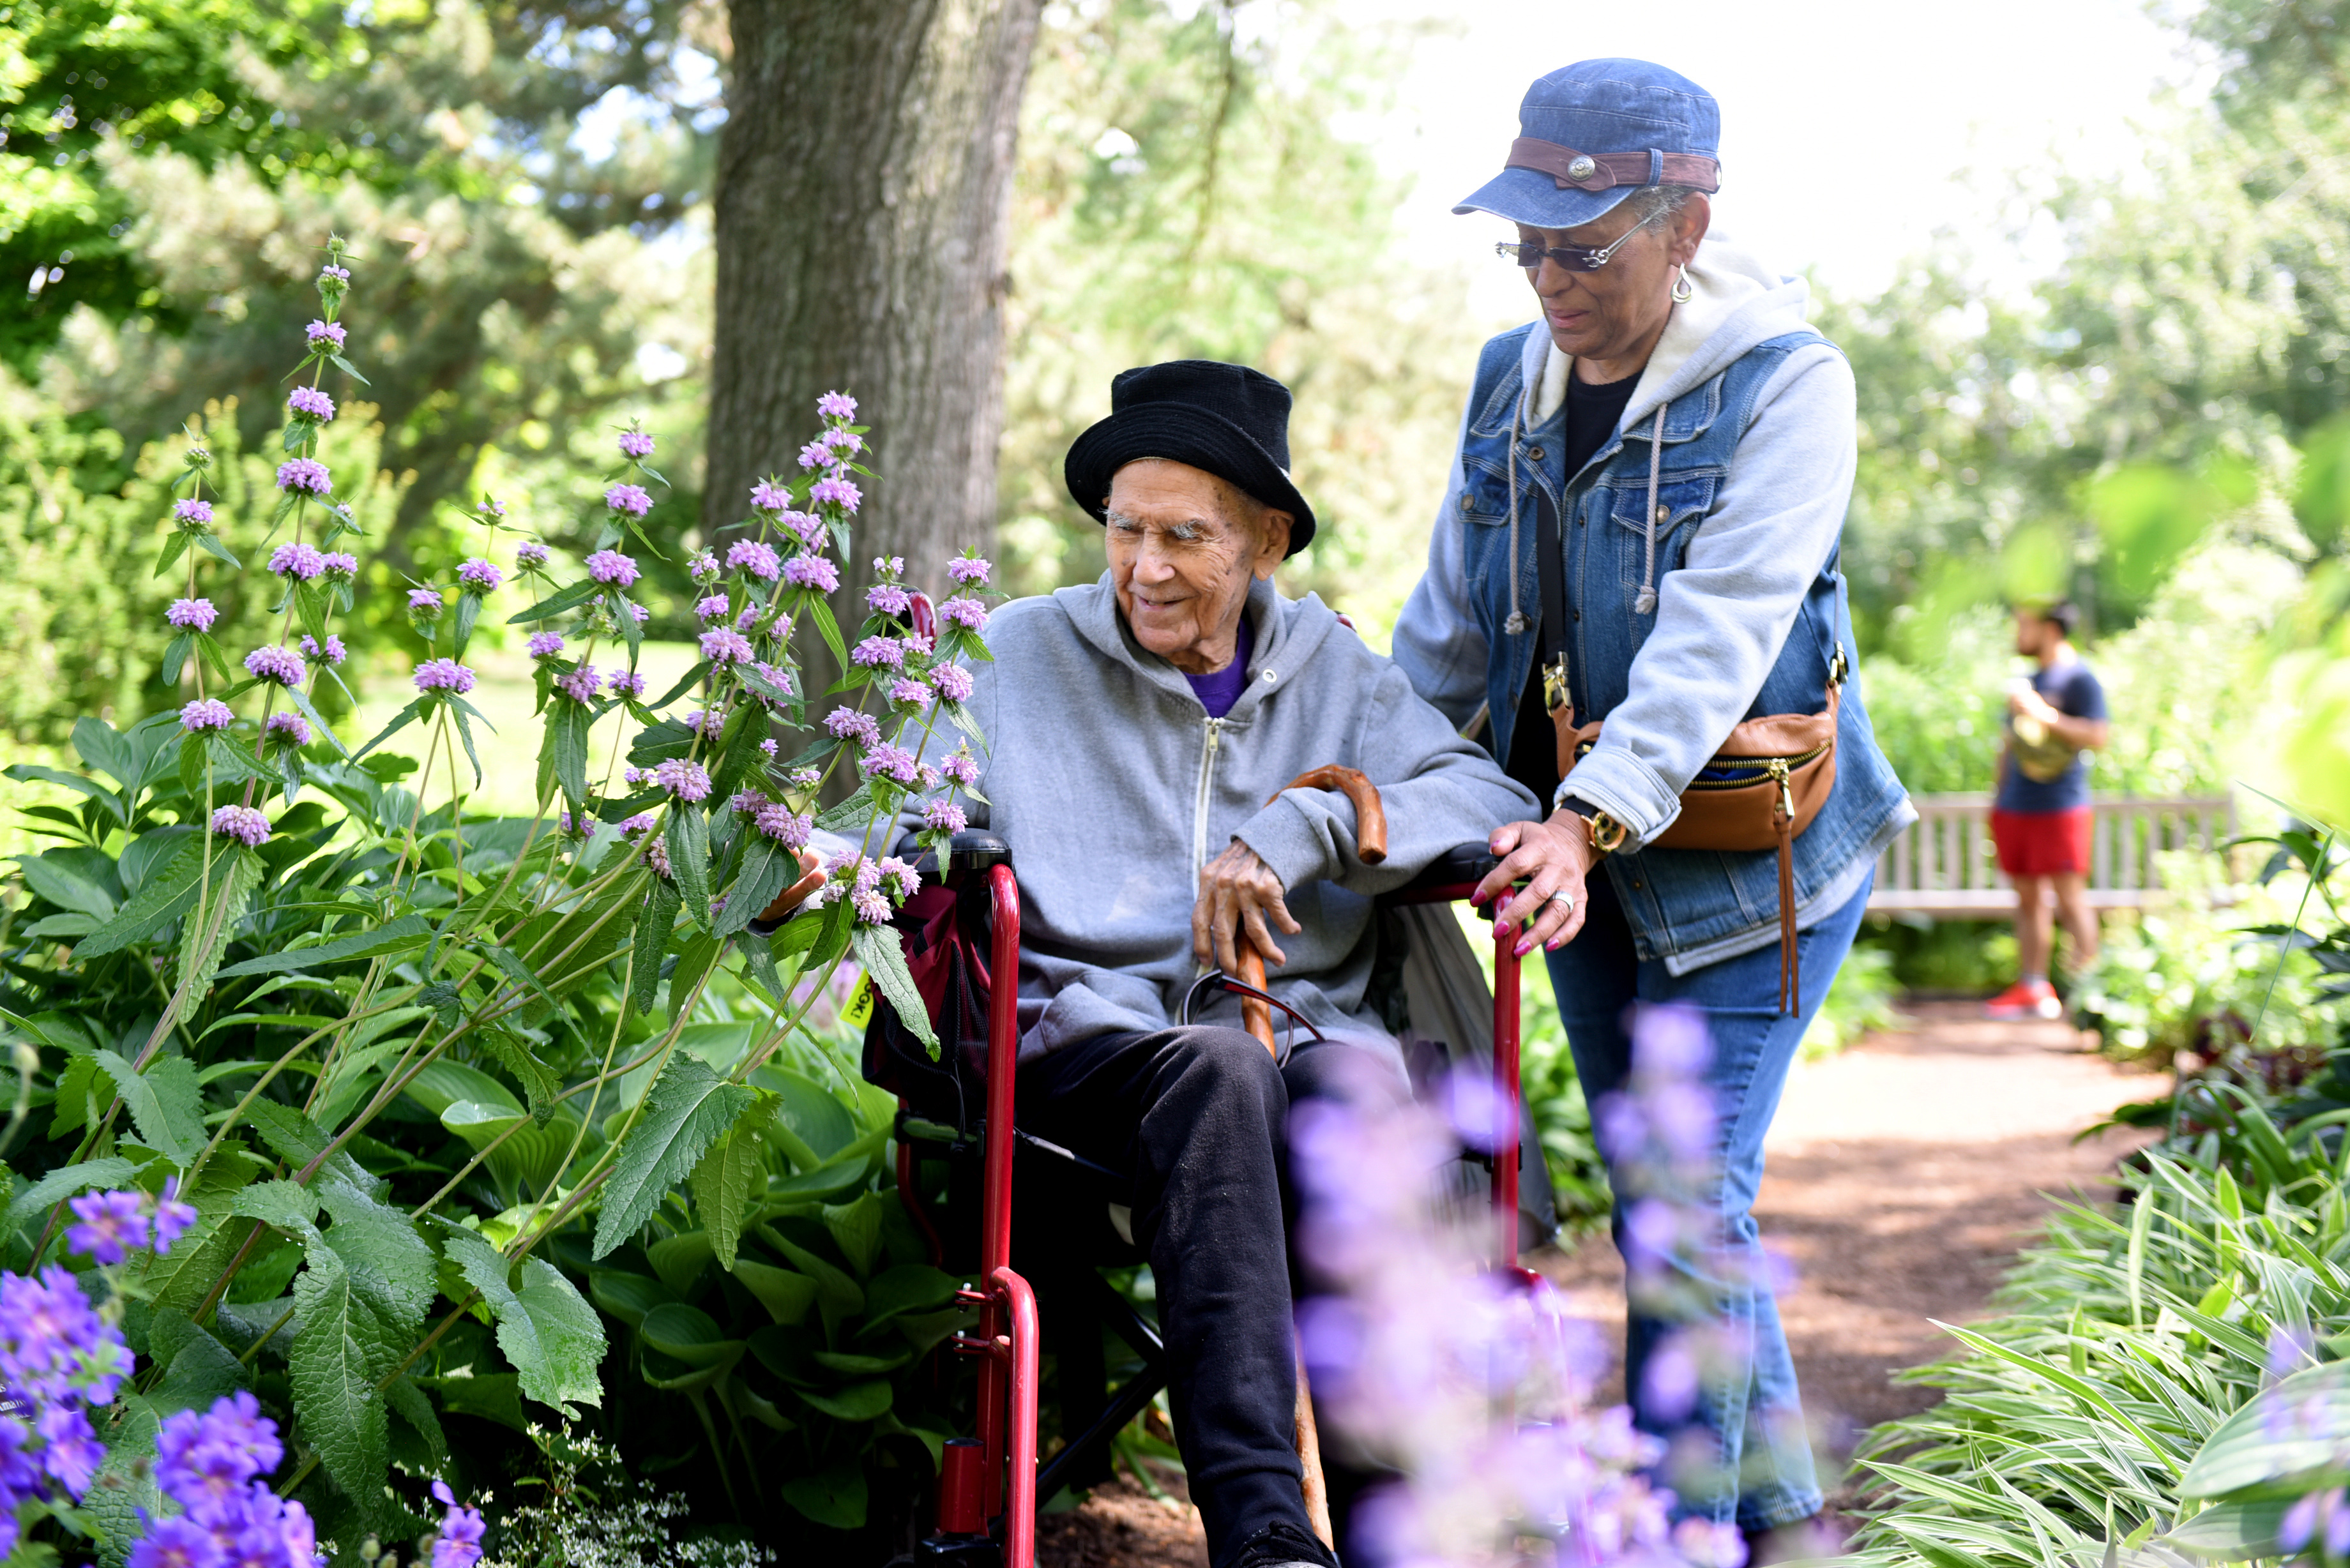
Why This Matters
Focus on
What Matters to the older adult
Improve
care coordination
Enhance patient safety
Prepare
to align with regulatory requirements (CMS
Age-Friendly Measure, CARE Act)
Enable
high-quality
care
When we engage caregivers, we:
Identification is the necessary FIRST step.
Notes:
Possible talking points:
When we engage caregivers, we:
Focus on What Matters to the older adult: Fosters more informed decision-making and reinforces trust.
Improve care coordination: Ensures effective collaboration across settings and care transitions. Ensures providers can reach the right person, communicate timely information, and collaborate effectively.
Enhance patient safety: Supports informed care, which is safer and lowers risk of readmission.
Enable high-quality care: Boosts support for caregiver well-being and patient outcomes, as well as quality metrics (e.g., CMS Age-Friendly Hospital Measure caregiver stress requirement, CARE Act).
Identification is the FIRST step, have to start here if you are thinking about measuring caregiver burden or ways to support caregivers.
NOTE:
Learn more about the Case for Caregiver Support in Hospitals: https://www.capc.org/documents/download/1301/

Slide 9

Getting Started
Gather a team to design and test a process
Engage with leadership to normalize asking
Start small with one area, unit, program, or clinic
Map out how processes work
Try out a new process with one older adult and learn from it
Collect and share the impact
Measure and track what success would look like
Notes:
Possible talking points:
Gather a team to design and test a process. Include older adults, caregivers, clinical and executive staff, and IT or informatics to support integration with the electronic health record (EHR).
Engage with leadership to normalize staff asking about caregivers, which may be a culture change.
Start small with one area, unit, program, or clinic that welcomes improvement work.
Map out how processes work now and who does what. Visualizing the current state helps you see where you may want to changes the way you do things or who does what. Then map out the ideal process, including who will do what. You can use a simple flow chart or a tool called a process map. A sample is on the next slide.
Try out a new process with one older adult first. Learn, adapt, and refine the process and try it with a few older adults next. Continue to expand the group you try it with to see what you might want to change/adapt before integrating it into standard practice. This helps gain team confidence when trying something new.
Collect and share the impact (of what you are learning) on organizational goals, clinicians and staff, and patient outcomes.
Measure and track what success would look like. How do we know this is working? What metrics could we track to tell us?
Think about measures to track the process of asking and documenting such as: % of individuals (or patients) who have been asked about care supports, % of individuals who have documented caregiver(s) information in the EHR.
Also consider the ultimate outcomes you are hoping for. This could include older adult-specific outcomes such as reduced readmission rates, reduced emergency department revisits, etc. This could include caregiver-specific outcomes such as reduced caregiver burden, etc. It helps to ensure that your team knows the ultimate goal.

Slide 10
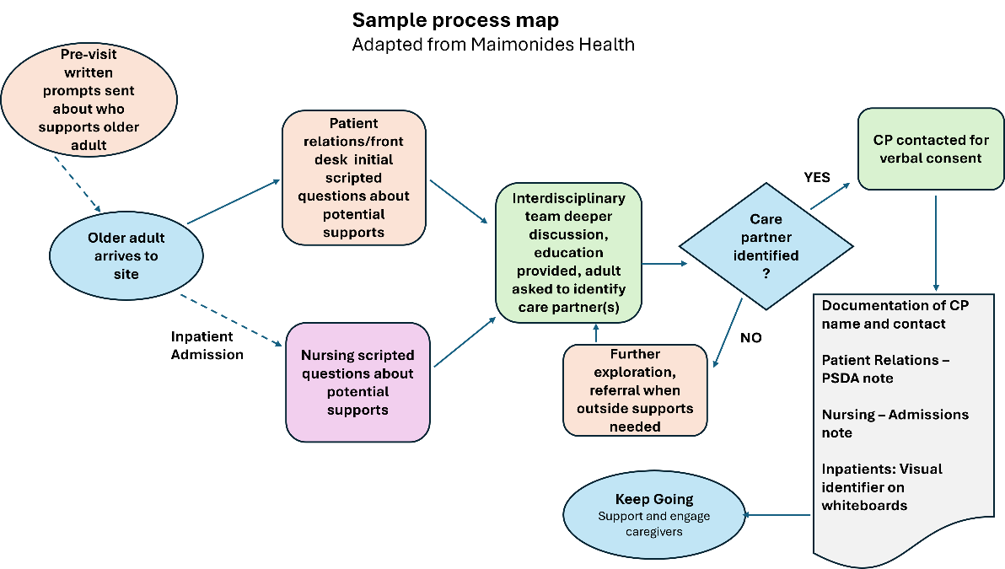
Sample Process Map
Maimonides
Medical Center in NY designed, tested, and implemented a process. The team increased their caregiver identification rate from less than 20 percent to 60 percent.

Slide 11
Use Different Opportunities to Ask and Document
Opportunity | Questions to Try | Who/How
Scheduling | “Is there anyone you would like to include in conversations about your medical care?” | Scheduling staff
Before a visit | After emergency contact, ask, “Does anyone else support you with your care?” | By mail or via patient portal
At arrival or registration | “Did anyone come with you today? Would you like them to help with your medical decisions?" “Who should be able to access your health information?" | Registration staff can ask. Register caregivers in the patient portal. Confirm any existing information.
During care | “What help do you need with [activity]? "Do you have someone who helps you? Who?” | Nurse, social worker, community health worker can confirm roles and relationships as part of existing assessments, such as activities of daily living or social determinants of health.
Serious event | Emergency contact or medical power of attorney may be all the information that is needed. | Discharge nurse or other team member can ask about caregivers later (as appropriate) for ongoing care planning and discharge support.
Notes:
Possible talking points:
Each opportunity will be unique. During scheduling, the question might be simple, e.g. "is there anyone you would like to include in conversations about your medical care?" Pre-visit questions are often administered via a mailed questionnaire or patient portal where more detailed information about caregivers can be asked and recorded (e.g. after asking for emergency contact, ask “Does anyone else support you with your care?”). When a patient arrives for an appointment, the registration staff can ask simple questions similar to a scheduler (starting with “Did anyone come with you today?”) and/or confirm caregiver information already in the record. When registering patients on arrival ask “Is there anyone you want involved in your care? Who should be able to access your health information?" and register them in the patient portal at that time. During an appointment/care delivery, clinical staff (e.g. admissions nurse, social worker, case manager) and community health workers have an opportunity to dig deeper to confirm caregiver roles, relationships, and needs . Consider integrating questions into existing initial assessments. For example, include it into ADL questions: “What help do you need with…” and “do you have someone who helps you?” Continue to ask/update these same questions during each care episode – they are useful for identifying if a caregiver is needed and/or if current caregiver is able to still provide care. Or, every nursing home has structured care plan conferences which are valuable for all caregivers to get on the same page; use this to circle back and define roles and talk about this.
Continue to ask these questions during routine patient interactions (e.g. in a nursing home, use care plan conferences) and update documentation over time. Identify if a caregiver is needed or the current caregiver is still able to provide care.

Slide 12
Relationship Builders (or Breakers)
“Asking about caregivers is not just for providers.
Frontline staff, schedulers, admissions, etc. are the first point of contact for patients, so they should start this process. That first entry conversation is so critical – really erodes trust when they don’t ask and listen.”
—Rosie, older adult and care partner
Notes:
Possible talking points:
Patients/caregivers have noted front desk staff can be so critical as first relationship builders or breakers.
Read quote.

Slide 13
Ways to Start the Conversation
With the older adult:
  “I’m going to ask you some questions to get
  a better idea of who assists/supports you…”
  “Does a family member/friend help with medical care, household needs, shopping, or other help?” *
  “Is there anyone at home with you, or do
  you live on your own?“
  “Do you help anyone else with daily or occasional care?” Older adults may be caregivers for others.
With a potential caregiver (with permission from older adult):
“I’m going to ask you some questions to help me get a better idea of who assists [the older adult].” **
*Adapted from Rush Caring for Caregivers (C4C) program | **Adapted from CAP-CT Caregiver ID tool
Notes:
Possible talking points:
There are many ways to take the conversation about caregivers deeper to gain a full understanding of the older adult's life and current situation. Find the language that works for the older adults you are serving, with you, and your setting.
Important to not forget that the older adult might be a caregiver themselves

Slide 14
The Conversation: Things to Consider
Tailor questions to help identify caregivers.
Many do not think of themselves as caregivers.
Explain and communicate the role of caregivers.
Differentiate from other roles.
Understand your audience.
Prioritize inclusivity, including in language (e.g., recognizing older adults without family or a caregiver).
Ask: How does the older adult
want the caregiver(s) involved?
Identify one main contact.
Integrate routine caregiver assessment and documentation into current workflows.
Continue the conversation.
Roles may not yet be defined.
Notes:
Possible talking points:
Tailor questions to help identify caregivers: Many don’t think of themselves as a “caregiver” as that seems like an official role. Start by asking the right questions to help uncover and explain who a caregiver might be or what a caregiver entails. Use terminology or activity-based inquiry that resonates locally (with older adults). Consider multiple formats - verbal, video, audio, written handouts - to help explain.
Explain and communicate the role of caregivers: Clearly differentiate caregivers from other roles like emergency contacts or health care proxies, focusing on the support provided rather than strict definitions. Broadly socialize the concept— that older adults may have one or multiple caregivers for different needs and that this role adds real value to care—helps normalize and elevate it. Help patients and caregivers describe themselves as a care dyad—through language, self‑identification, or simple tools—so they can better advocate for their role. Reinforce this clarity through consistent messaging, such as scripts that explain how caregivers differ from proxies
Understand your audience: prioritize inclusivity, including the language you use. Keep an eye out for non-traditional or chosen families, complex families dynamics, non-English speakers, those with disabilities (e.g. low hearing, vision) - ensure language (terminology and spoken language) used to ask about care givers doesn't isolate or leave anyone out. For example, for older adults without family or a caregiver use especially thoughtful and respectful language when asking about support. Some individuals truly have no one, while others may not agree with a potential caregiver about the role due to complex family dynamics or cognitive challenges like dementia. Focus on understanding their situation without assumptions and help connect those without support to appropriate community resources—such as a social worker or other local services.
Ask: How does the older adult want the caregiver involved? After the caregiver(s) is known, it is important to confirm how the older adult wants them to be involved; And be sure to remember autonomy - not all older adults want caregiver for all things (or info shared).
Identify one main contact: especially if multiple caregivers are identified, make sure to have one main person to funnel information through.
Integrate routine caregiver assessment and documentation into current workflows/tap into existing clinical encounters as additional step (rather than creating entire new process) e.g. as part of SDOH or Medicare AWV screening, as a field in MyChart, asked during pre-visit survey. Find out where information sharing is already flowing very easily from one care point to another and across transitions of care; tap into this current workflow and add asking about caregivers as a step.
Continue the Conversation (circling back): Roles may not yet be defined (especially in emergency situations or upon new diagnosis) and may require triangulation once trauma settles (e.g. post-acute care folks may need time to process care needs/roles).
For example: Maimonides Medical Center uses a patient relations script that has a narrative to distinguish between health care proxy and caregiver—these are often (not always) different

Slide 15
Document the Caregiver(s) in the EHR
Try this:
Use the EHR face sheet for various role types (could be drop down or box tick).
Use separate fields for caregiver, emergency contact, and medical power of attorney in case they differ.
Add caregiver information automatically to standard notes (e.g., nursing and discharge summaries). Will documentation in a flowsheet make it available across encounters and reports?
Make information available quickly. Can you reduce clicks, make fields hoverable, or use dot phrases?
Ensure permission and information release forms are easily accessible and process for completion is
in place
Notes:
Possible talking points:
Documenting the caregiver or multiple caregivers in the electronic health record ensures the care team knows who supports the older adult and involves them appropriately.
Try this:
Use the EHR face sheet for various role types (could be drop down or box tick).
Use separate fields for caregiver, emergency contact, and power of attorney in case they differ.
Add caregiver information automatically to standard notes (e.g. nursing and discharge summaries). Will documentation in a flowsheet make it available across encounters and reports?
Make information available quickly. Can you reduce clicks, make fields hoverable, or use dot phrases?
Many sites will need to make changes to the EHR. Start by understanding what you need and what you are trying to accomplish. Explore what is feasible and who needs to be involved.
Ensure permission and information release forms (for caregivers granted access to health information) are easily accessible and process for completion is in place.

Slide 16

The EHR: Things to Consider
Understand how your EHR works
and what is feasible
A clear ask: Understand your organization’s policies around EHR updates. Who is the key contact — someone in IT or a compliance officer?
Would automatic prompts/
checklist help?
Consider how to document changes: Complex family and caregiver situations may need ongoing discussion with
the interdisciplinary team.
Notes:
Possible talking points:
Understand how your EHR works, who to ask for changes, and what is feasible: this will help in any updates needed and/or redesign of documentation fields. The better the IT build is, the easier it is to collect/analyze data, measure outcomes, and make improvements. Considerations include:
Can POA, emergency contact AND Caregiver have unique fields on the face sheet so that they can be pulled into other documentation/templates automatically (these roles can be filled by different people)?
Ensure caregiver information is available to all types of providers with minimal clicks. Do we need documentation in a flowsheet so the information is available across encounters, providers, and available to pull into reports? Can/should we use Smart Phrases and Dot phrases? Can fields be hoverable? What can be done within current restraints (in your EHR structure)? Who do you need to involve and at what point?
A clear ask: Understand your organization’s policies around EHR builds and start the process by being clear on what you need from a technology standpoint- What is the ask? What are we trying to accomplish? What do we wish to change? Does it bring value? Consider documentation burden when planning changes. Your key contact may be in IT. One system went straight to their compliance officer noting that documenting caregivers was part of the CARE Act, so they needed to get this into the EHR to be compliant with state law. This prompted rapid change.
Would automatic prompts/checklist help? Consider building a checklist or assessment tool into EHR (recommend to add to existing assessments)
Consider how to document changes: Complex family and caregiver situations may need ongoing discussion with the interdisciplinary team. Rounds may be a good time for these discussions in the hospital, care plan conferences in nursing homes. Plan for how to document any role changes/complexities in your EHR .

Slide 17
The EHR: Things to Consider
Consider a few essential fill-in fields, such as:
  Caregiver name
  Relationship
  Phone number
  Lives with care recipient (Yes/No)
  Serves as primary caregiver (Yes/No)
If there are multiple caregivers: How will you capture this?
Notes:
Possible talking points:
If you are looking for specific fields to help the IT team get started, these fill in fields may be considered essential (caregiver name, relationship, phone number) and these Y/N fields are helpful to note if they are the primary caregiver (especially for those with multiple supports) and if they live with the care recipient.

Slide 18
Beyond the EHR: Things to Consider
Use visual displays to actively engage caregivers to self-identify (e.g., bedside whiteboards)
Consider having printed worksheets for the team as part of standard intake process or assessments
Notes:
Possible talking points:
Consider options outside of the EHR, such as:
Use visual displays: to actively engage caregivers to self-identify. For example, list caregiver names/roles on the white board in the older adult’s room; families can see and update it if needed. This is another way to ensure caregivers are aware they are named and willing to take on that role.
Consider having a printed worksheet for HC team as part of standard intake forms to use as a reminder to ask and document (either in addition to EHR fields or until EHR capability can be built).

Slide 19

Keep Going
Standardize caregiver identification and documentation in workflows, policy, and the EHR / patient portal.
Train all team members to identify caregivers and ensure they are clear about various role type. Address potential biases, including ageism (stereotypes, prejudice, or discrimination based on age).
Share caregiver information during transitions of care (e.g., in discharge paperwork).
Notes:
Possible talking points:
Standardize caregiver identification and documentation in workflows, policy, (e.g. Add caregivers into your Age-Friendly Health Systems mission) and the patient portal. Make supporting strategies standard of care for everyone. An example: make pre-visit agenda setting standard practice, letting all older adult know you’d like to discuss who might be supporting them with care or daily activities at the upcoming appointment/next visit
Train all team members to identify caregivers. Ensure they are clear about various role types (difference of a caregiver to that of an emergency contact, health care proxy (i.e. medical power of attorney/power of attorney for health care/health care agent), and next of kin. Many may serve in more than one of these roles, but don’t assume they are the same. Address potential biases, including ageism. (stereotypes, prejudice, or discrimination based on age)
Share caregiver information during transitions of care (e.g., in discharge paperwork).

Slide 20
Keep Going
Support and engage caregivers. Identification is the first step.
Use evidence-based screening tools to identify caregiver stress (e.g., Burden Scale for Family Caregivers). This also aligns with the CMS Age-Friendly Measure. Other assessment options can be found on slide 36.
Connect to resources such as:
Caring for Caregivers (C4C) Technical assistance available to health systems
Caregivers As Partners in Care Teams (CAP-CT): Free education and resources for healthcare teams
U.S. Department of Veterans Affairs: VA Caregiver Support
Center to Advance Palliative Care (CAPC): Caregiver Support Program Implementation Toolkit
Notes:
See more caregiver stress assessment options on slide 36.
Possible talking points:
Support and engage: Supporting caregiver and older adult dyads cannot happen without first identifying and clarifying those relationships. caregivers are a critical part of the HC team. This work helps to normalize their expertise and involvement. This may be a culture change in your organization that requires patience and persistence.

Slide 21

Idea to Test: Shared Portal Access
Ask older adults to identify caregivers by adding them to their patient portal themselves.
Benefits: Autonomy respected; older adult can define how the caregiver(s) should be involved and what information they should have access to; less burden on the health care team
Challenges: Older adult may not keep the portal up-to-date — especially in emergency situations; health systems may require the caregiver to also be a patient.
Portal access is not a substitute for asking and documenting.
Notes:
Possible talking points
Consider using shared patient portal access as one way for older adults to identify caregivers (offers sense of agency when they have control of who gets access their health information). Consider this in addition to (not a replacement for) conversations between the older adult and health care team
Note to be aware of:
Be aware of rapidly expanding technology—shared portal access might leave some older adults and caregivers behind. Shared portal access is not a substitute for HC teams having these conversations and documenting the results.

Slide 22
Tools and Resources

Slide 23
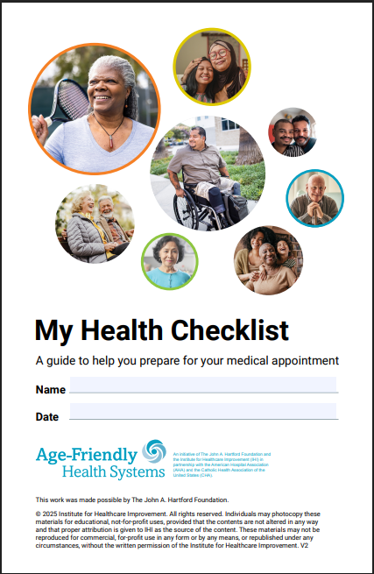
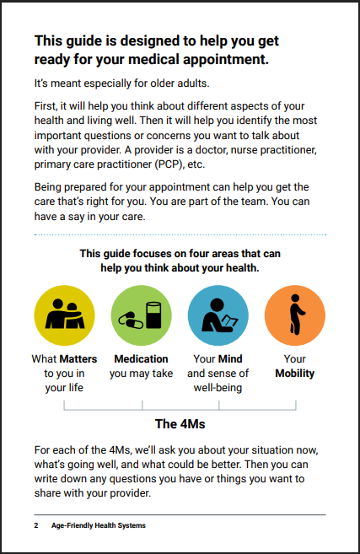
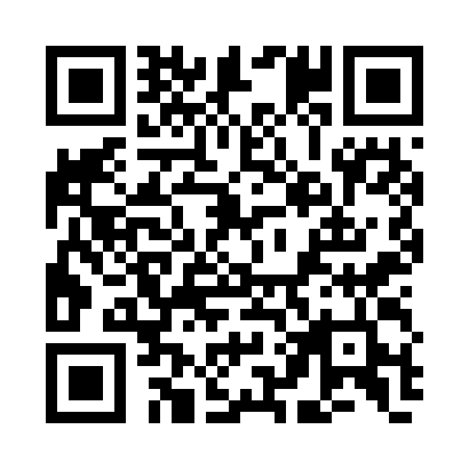
My Health Checklist (multiple languages and audio version)
ihi.org/myhealthchecklist
Notes:
My Health Checklist: a resource for older adults and caregivers to help prepare for appointments. Encouragement of shared decision making can build trust.
Currently My Health Checklist is available in 8 languages (English, Spanish, Chinese, French, Japanese, Portuguese, Tagalog, Vietnamese) and an English audio version.

Slide 24
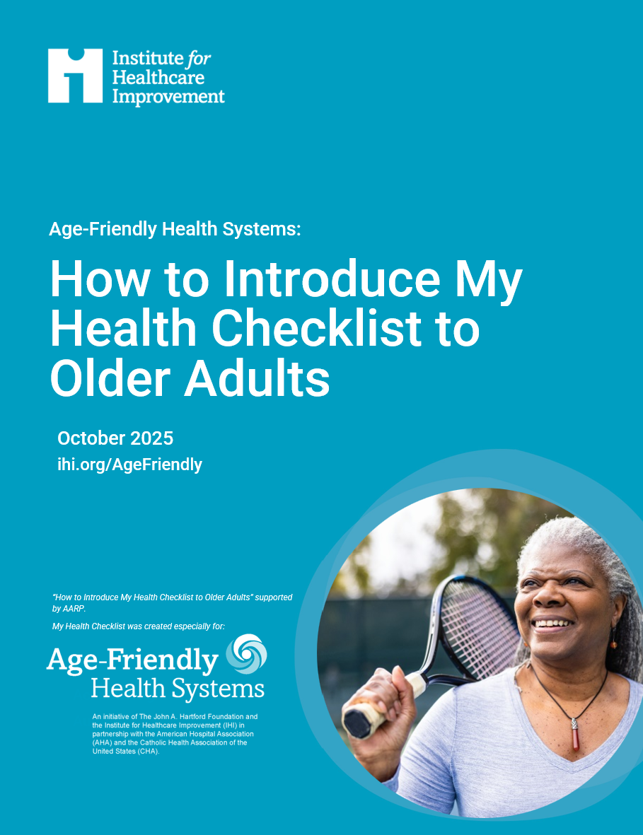
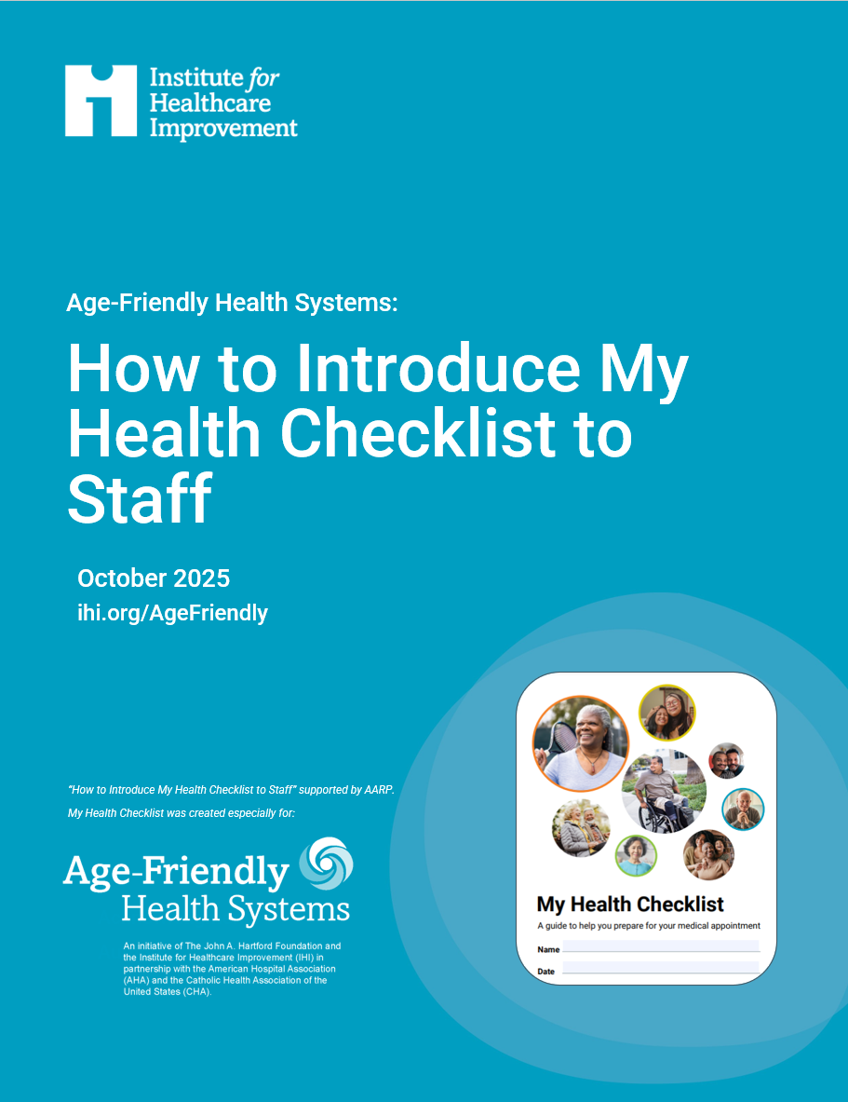
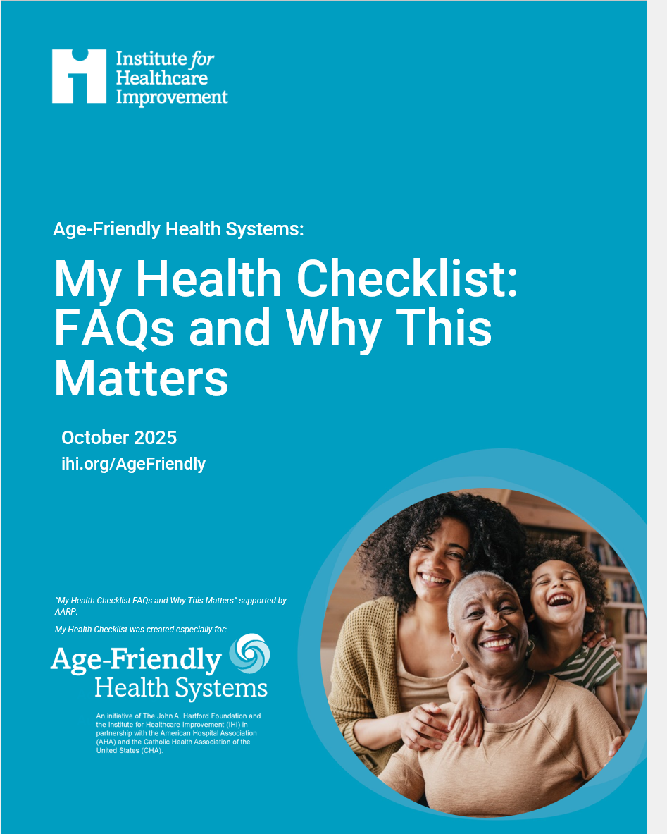
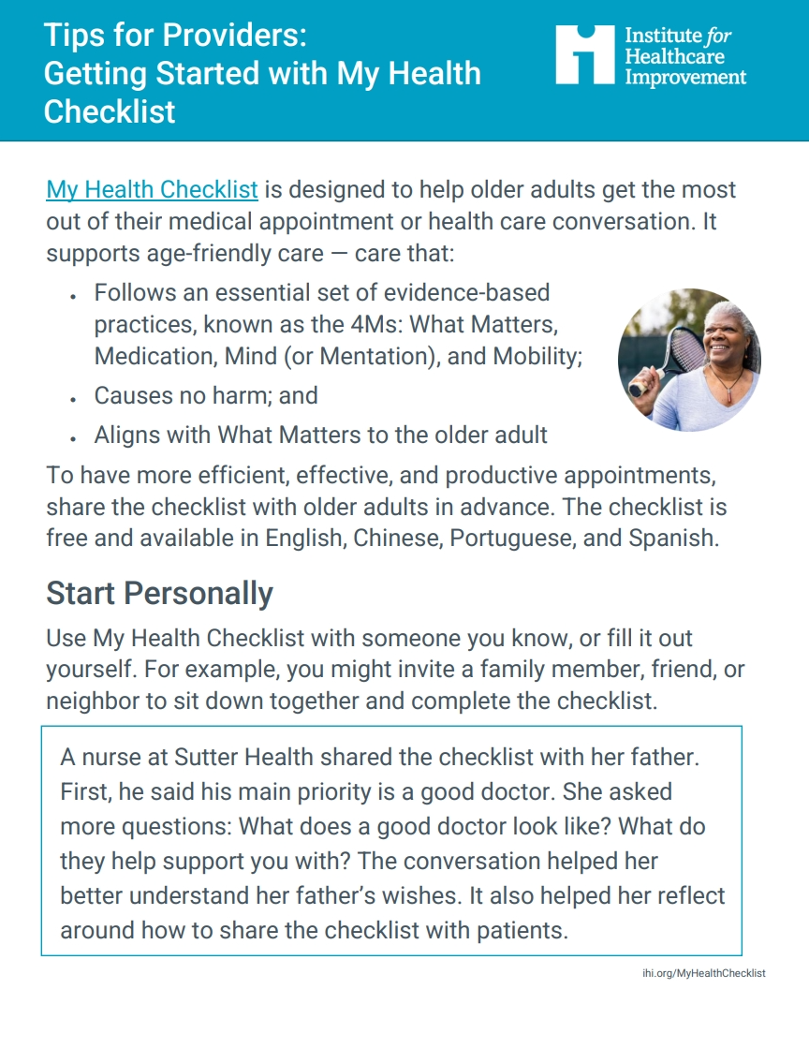
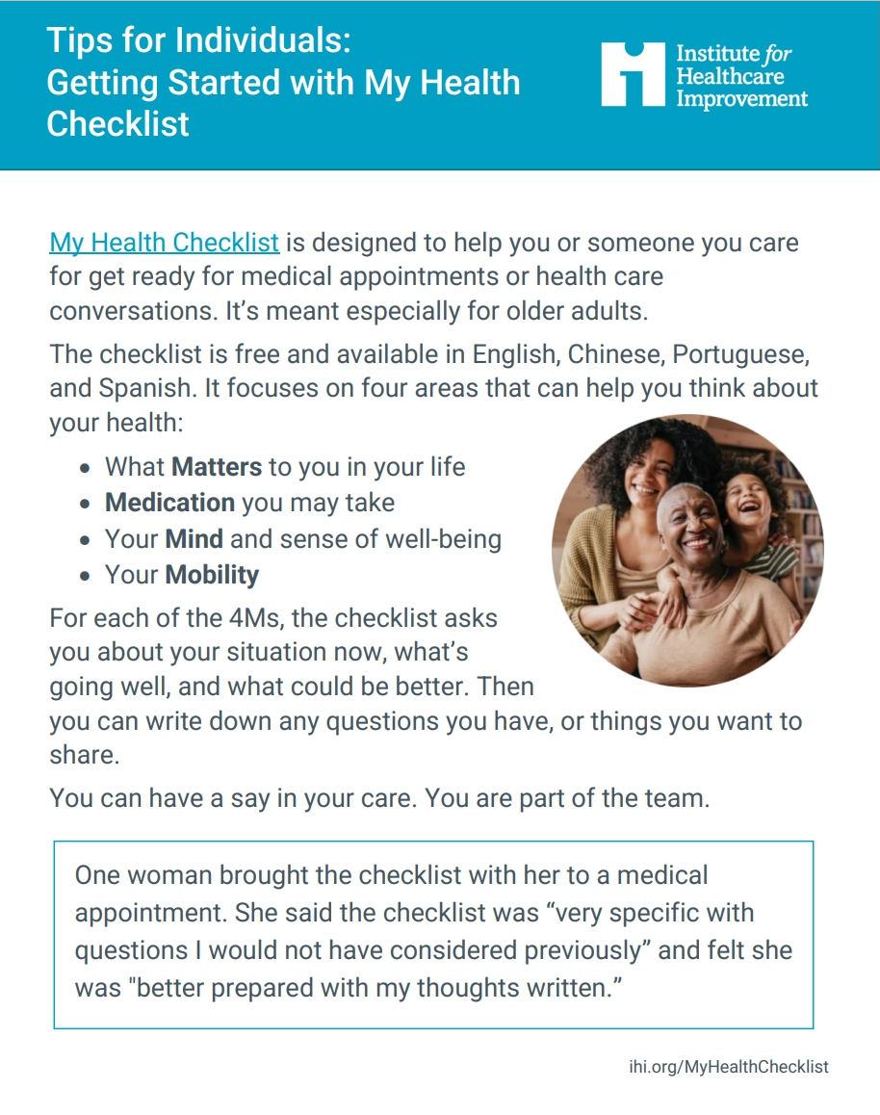
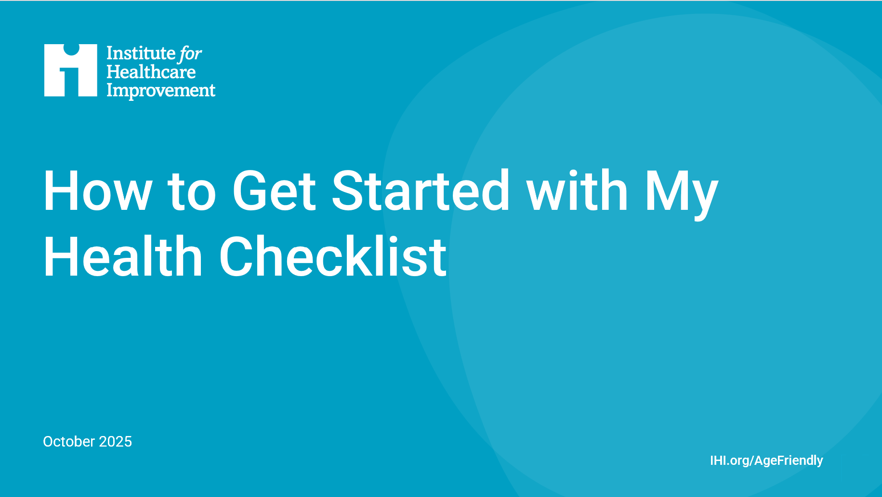
Download guidance for sharing My Health Checklist
Notes:
Other resources related to My Health Checklist:
At ihi.org/AgeFriendly you can find resources and guidance for sharing My Health Checklist: https://www.ihi.org/partner/initiatives/age-friendly-health-systems/resources-and-news#block--6936
These resources grew out of lessons learned from organizations across the U.S. that took part in IHI-led and AARP‑supported learning communities designed to explore how My Health Checklist could be used within their organizations and the communities they serve.

Slide 25
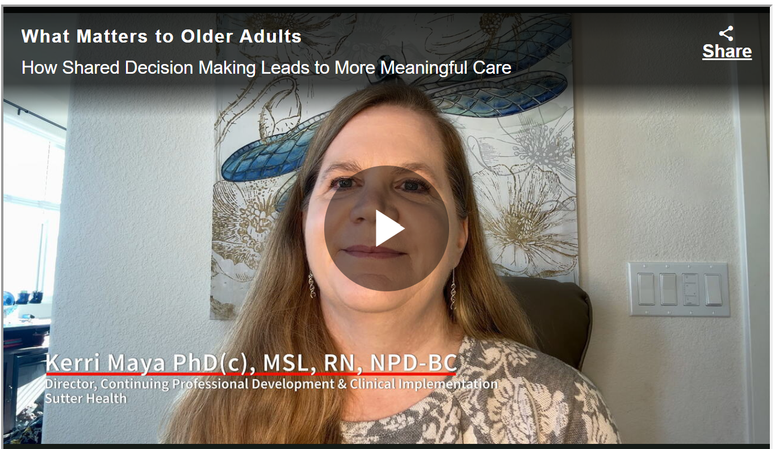
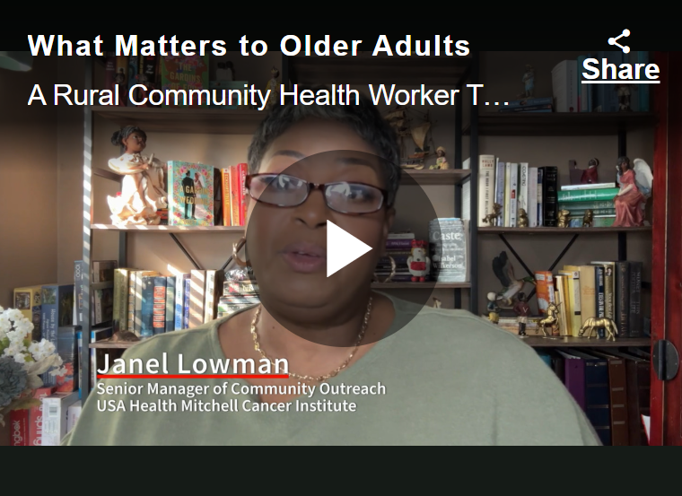
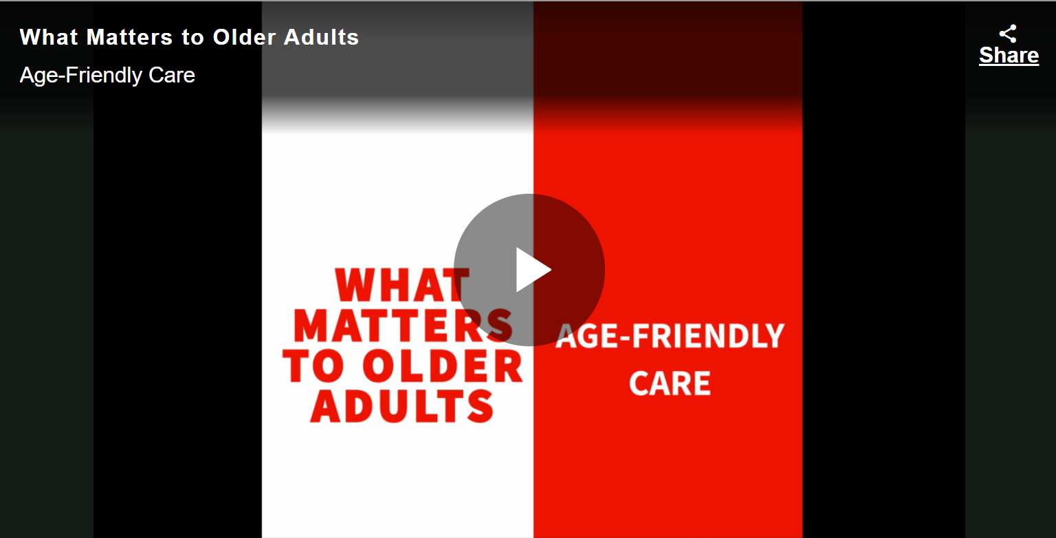
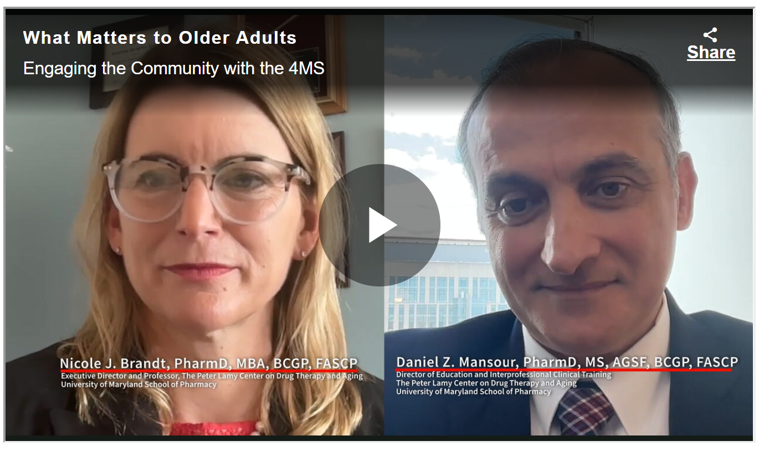
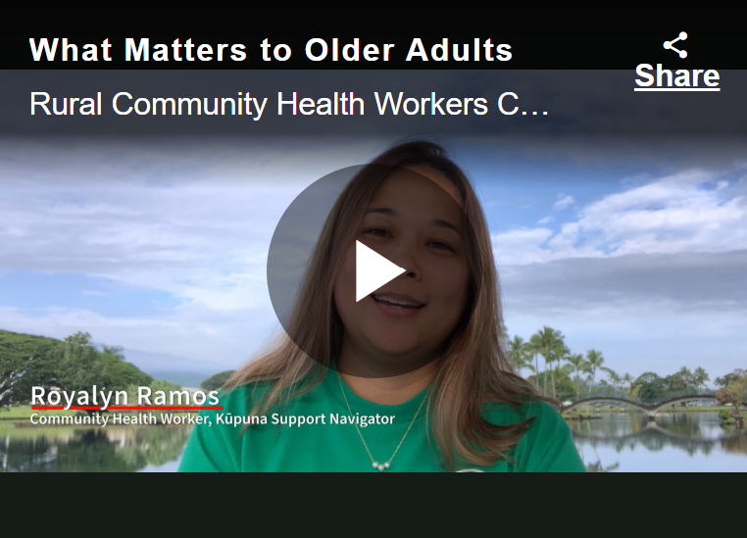
AARP Resources
Resources from AARP, including videos of physicians, nurses, community health workers, older adults, and caregivers talking about how shared decision-making leads to more meaningful care and engaging the community with the 4Ms

Slide 26
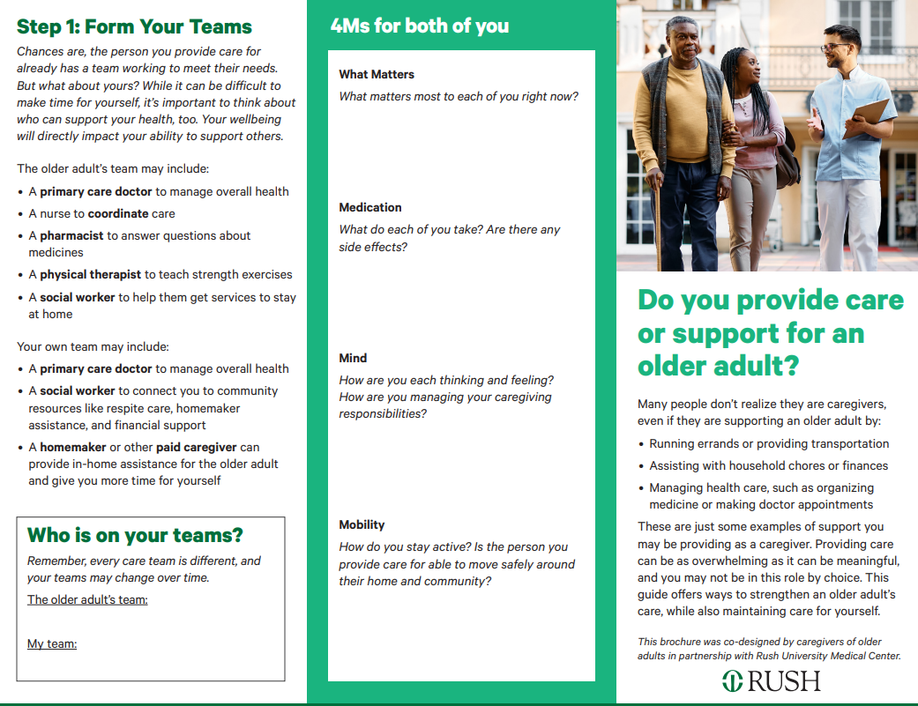
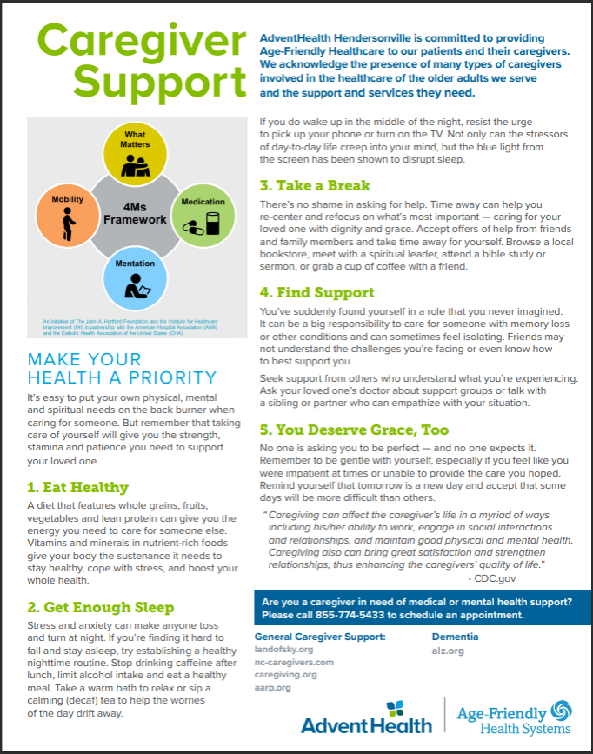
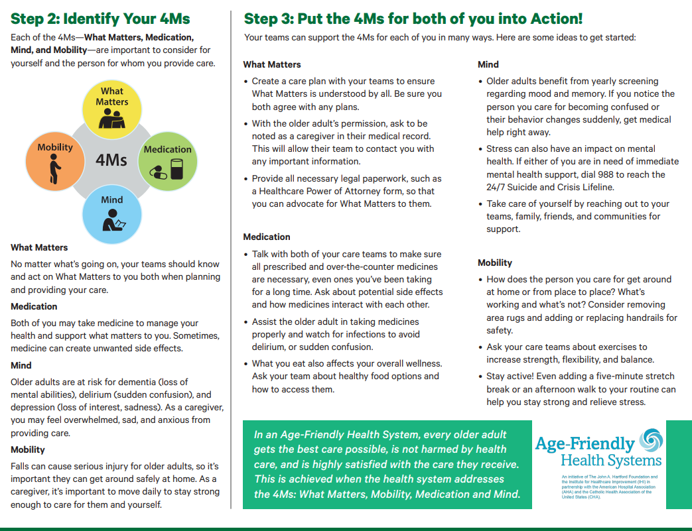
  C4C Trifold for Caregivers
  AdventHealth Hendersonville Caregiver Handout
Notes:
Use existing or create your own one pager. For example, a handout that defines what a caregiver is so they can think about it and then advocate for and self-define who they want helping them. Use the above and the following slide as inspiration for customized resources.
(above) C4C Trifold for caregivers: this resource encourages caregivers to ask providers, with the older adult’s permission, to be noted as a caregiver in the medical record. The trifold also emphasizes the importance of the 4Ms for the caregiver themselves.
(above) AdventHealth Hendersonville gives out this caregiver resource flyer in the ED and inpatient settings

Slide 27
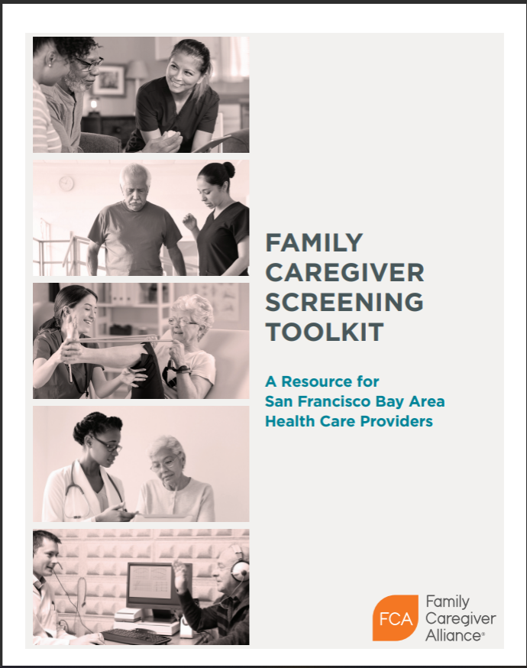
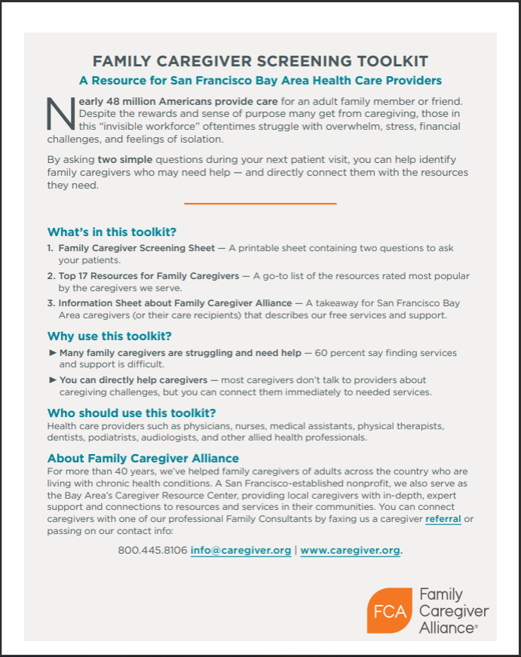
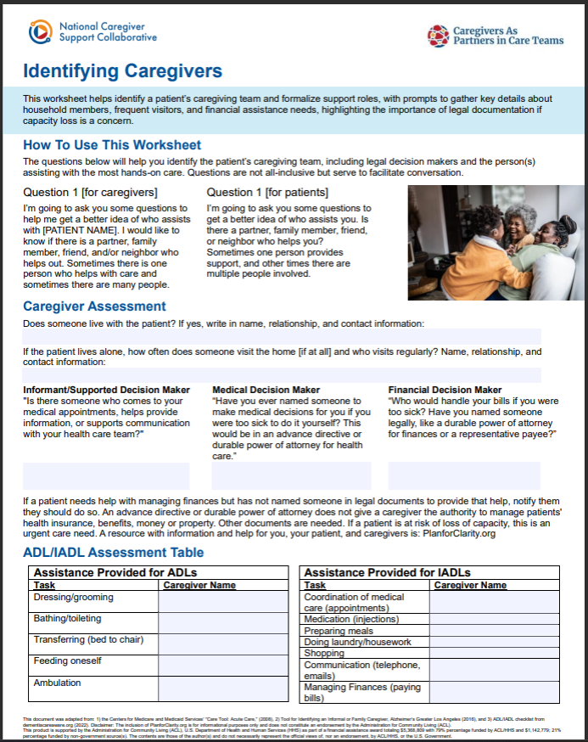
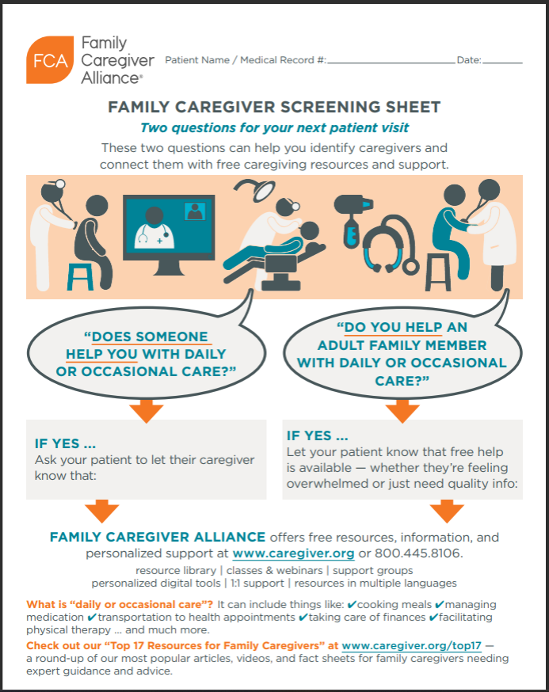
CAP-CT Caregiver Identification Tool
Family Caregiver Alliance: Family Caregiver Screening Toolkit
Notes:
Additional resources that can be used or serve as inspiration for creating your own customized resources.

Slide 28
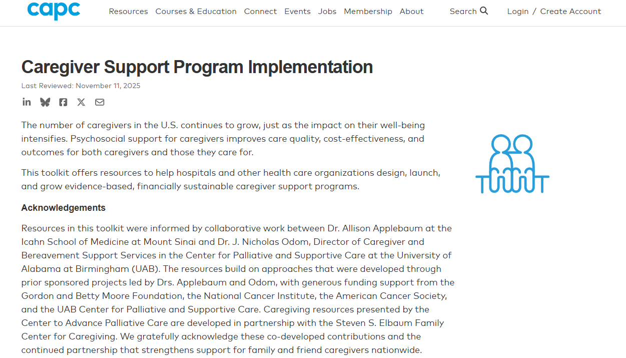
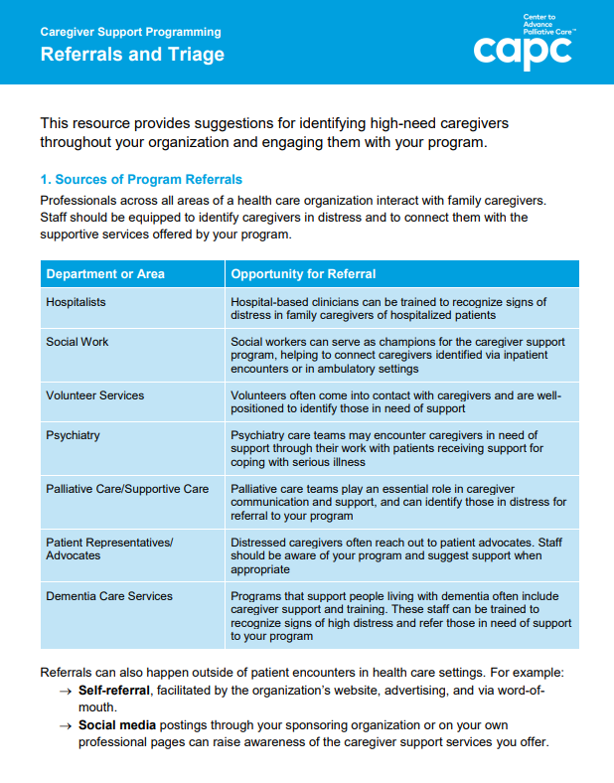
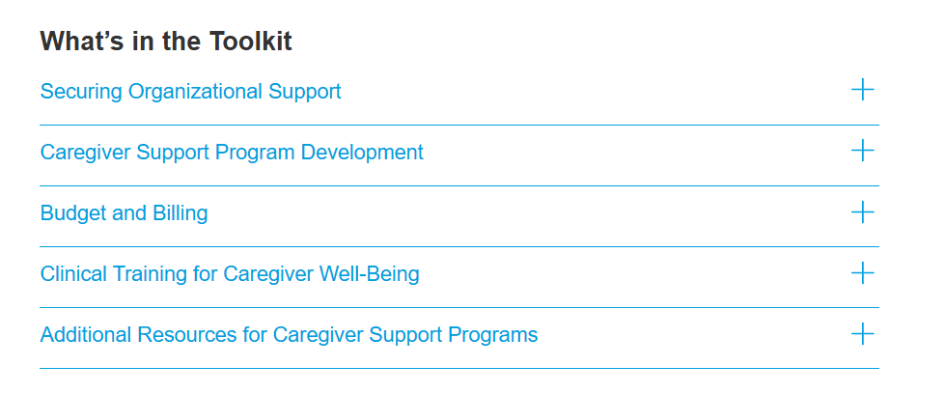
CAPC Caregiver Support Program Implementation Toolkit
Notes:
Additional resource for identifying and engaging with high-need caregivers. Can also be used as inspiration for creating your own customized resources.
The CAPC Caregiver Support Program Implementation Toolkit is aimed at building a mental health support program for caregivers. Learn more about the Case for Caregiver Support in Hospitals: https://www.capc.org/documents/download/1301/

Slide 29
Case Examples

Slide 30
Presbyterian Senior Care, PA (Nursing Home)
On admission, staff record the resident’s power of attorney (POA) on the face sheet. Within 7 days of admission, the social worker administers a social history to ask more detailed questions about caregiver support. This information is recorded in the EHR and accessible to clinical staff.
Care Plan Conferences are offered soon after admission and includes everyone who supports the resident. This process creates a consistent pathway for the facility to understand each resident's unique caregiver situation.
Primary contacts and role types are recorded on the face sheet. POA is always the first entry. This can be updated as needed. The EHR has communication templates to pull out notes on given topics. A 4Ms care plan template is built into the EHR, and social worker notes can be pulled up (using Point Click Care).

Slide 31
Maimonides Medical Center, NY (Hospital)
Maimonides uses a team-based, multi-touchpoint approach:
Patient representative asks on admission and documents in Patient Self-Determination Assessment (PSDA) and nursing asks in admission assessment (nursing intake form and note). If one has already asked, the other confirms. Name and phone number are documented.
Staff call caregiver for verbal consent.
Caregiver information is documented on patient room white board.
Asked again on the discharge summary.
The team’s caregiver identification rate is consistently at ~60%.
Notes:
Possible talking points:
See slides 45-46 for an example process map and caregiver brochure from Maimonides

Slide 32
Bayhealth, DE (Hospital)
The team starts at registration:
First, registration staff record the emergency contact in the Demographics tab.
Then, the admitting nurse asks specifically about a caregiver, if the caregiver is aware of their role, and if they accept it. They record all information in an Admissions Navigator with prompts. (This is a flowsheet row in Epic.)
They define “caregiver” as an individual 18 years plus designated by patient that provides after care, while they define “agent” in legal terms.
Notes:
Possible talking points:
See slide 47 for example EHR screenshots from Bayhealth.

Slide 33
AdventHealth Hendersonville, NC (Hospital)
Identifying caregivers is a true team effort. Several clinical staff members ask near the time of admission.
Registration starts with an ask for emergency contact. The admitting RN asks for HCPOA. The hospitalist will ask about supports at home to understand discharge support. A case manager, who sees all older adult patients, conducts a detailed support interview that covers all aspects of caregiving and support.
Caregiver information is captured in the flow sheet (in EPIC), using smart and dot phrases.
Notes:
Possible talking points:
See slide 26 for an example caregiver handout from AdventHealth Hendersonville.

Slide 34
University of Alabama at Birmingham, AL (Hospital)
The team has a multi-step process, starting with identification of emergency contact and next-of-kin. (Alabama law requires next-of-kin identification.)
Admissions collects emergency contact info in a “patient info” tab. The caregiver conversation starts here with the RN.
The case manager follows up for more detailed assessment, digging deeper in an interview to determine who is really filling the caregiver role.
Caregiver information is captured in the ACP section of EHR and recorded in the case management assessment and notes documentation.

Slide 35
Scenario

Slide 36
Have you seen this happen before?
An older adult and caregiver are in an appointment together.
The older adult cannot absorb the information.
You give the caregiver detailed instructions and recommendations.
You follow-up with the older adult and caregiver after a few weeks and nothing has changed. Your recommendations have not been followed.
Is caregiver stress a possible factor?
Notes:
Note: this slide is to prompt a discussion and share about caregiver stress assessment resources
Possible talking points:
Consider the following scenario. What could be the possible reasons? Could it be a gap in teaching or understanding? Did you try teach back or other way to see if the instructions were understood at the time of appointment? Could caregiver stress be a possible factor?
Ask the caregiver: don’t assume. Try gentle asks that build trust (not blaming, putting them on the defensive). Try something like: Is everything ok? What is happening lately that would be helpful for me to understand?
Listen to what they are telling you: what is bubbling up?
Assess: if caregiver stress is a possible factor, try one of the recommended assessment tools (or your own if you already are using something). See next slide.

Slide 37
Caregiver stress assessment resources
Burden Scale for Family Caregivers
FamilyStrong Distress Thermometer
AMA Caregiver Self-Assessment
Zarit Burden Interview
CancerSupportSource™
Notes:
Note: this slide is to share a sampling of recommended caregiver stress assessment resources. These screening tools are just some available, validated instruments which institutions may elect to use but there may be others that are more suitable for a particular site/population served. It is important to review all potential tools and programs to determine what will work best in your institution.
Burden Scale for Family Caregivers is a valid instrument developed to assess the subjective burden of caregivers, helpers or support persons in the home environment. Repeated surveys allow for the evaluation of the effectiveness of interventions and support measures. To read more about the validity of this scale see: https://pmc.ncbi.nlm.nih.gov/articles/PMC3942019/
FamilyStrong Distress Thermometer is an adapted version of the National Comprehensive Cancer Network Distress Thermometer. It has been proven feasible and reliable for caregivers of patients with cancer and may be appropriate for caregivers of patients with other illnesses as well.
AMA Caregiver Self-Assessment was developed to help physicians assess the stress-levels of family caregivers accompanying chronically ill older adult patients to their medical visits, tested for reliability and predictive of caregiver stress.
Zarit Burden Interview measures the perceived burden of caregivers for patients with chronic illness, disability, or dementia. Note that perceived burden and distress may not fully correlate, but the Zarit is increasingly used to identify at-risk caregivers of those with dementia.
CancerSupportSource™-Caregiver 33-item, web-based tool that measures distress in six areas. It serves as a screening and triage tool, as well as an intervention by immediately notifying respondents of local resources that address targeted drivers of distress in the screening. Note this is specific to oncology and has not yet been evaluated in other populations.
Source of recommendations: Center to Advance Palliative Care (CAPC) and Caring 4 Caregivers (C4C).

Slide 38
Testimonials

Slide 39
Older Adults Say:
A caregiver is a built-in, existing support system and
knowledge partner.
“Care partners help us navigate and have a consistent historian with experience the facility doesn’t have. For those with complex health needs (and multiple patient portals), it’s even more important.”
— Rosie, older adult
“Caregivers serve as wellness partners for the older adult, important supporters of healing and recovery. For those who are immobile due to condition (temporary or permanent and rely 100 percent on someone else) caregivers help get the older adult around, collect meds, etc. They are compassionate supporters who help boost recovery.”
— Jacalyn, older adult

Slide 40
Caregivers Say:
Caregivers create efficiencies. Building trust is vital.
“Being recognized helps acknowledge my stress and builds trust. And, I can give you information to make your job easier. I can let you know what has worked in the past.”
—Libby, care partner

Slide 41
Providers Say:
Caregivers are valuable team members. Their unique insights support the older adult and health care team.
“There is an infrastructure built between patients and caregivers — understanding this saves clinicians time and possible mistakes (e.g. decreases difficulty of care and risk of harm). There is risk of "obliterating" What Matters when clinicians make assumptions and don’t engage older adults and caregivers. Caregivers understand the context of the story. They are part of the care team. And they typically are with the older adult across the whole continuum [the constant]. Caregivers support the healthcare system too.”
— Marie, provider and caregiver

Slide 42
Providers Say: (Continued)
“Knowing who the caregiver(s) is helps us know who to involve in follow-up conversations, what supports an older adults has when making medical recommendations, and if they will be able to do what we are recommending. Can they take tiny meds if they are shaky and can't actually grab a tiny pill? Do they have someone to help with meds? Or if What Matters to the older adult is going out to lunch, do they have transport or someone to help if this is needed to help them get there?”
– Marie, provider

Slide 43
Care Sites Say:
Partnership leads to efficient and effective care planning and streamlined discharge.
“Bayhealth, located in State of Delaware, is a top retirement state. Older adults are often living away from caregivers. It's vital to understand who and what support is available for discharge. Part of decreasing readmissions and having successful discharges is ensuring supports are in place. Also creates efficiency to know roles people play, ensures team members are calling the right person/role for the right reasons [or knowing who the main point of contact may be].”
– Felicia, provider

Slide 44
Sample Tools from Sites

Slide 45
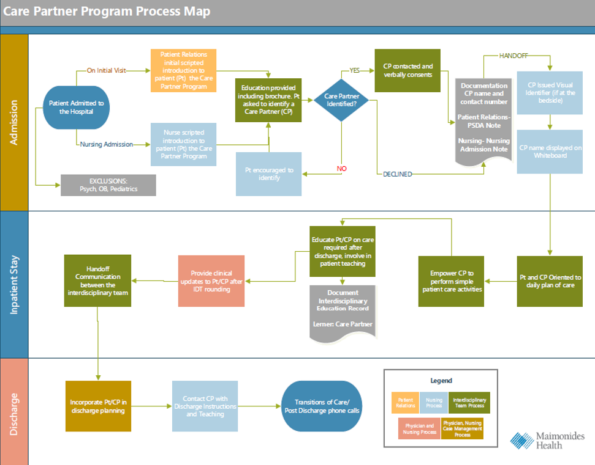
Maimonides Medical Center, NY: Process Map

Slide 46
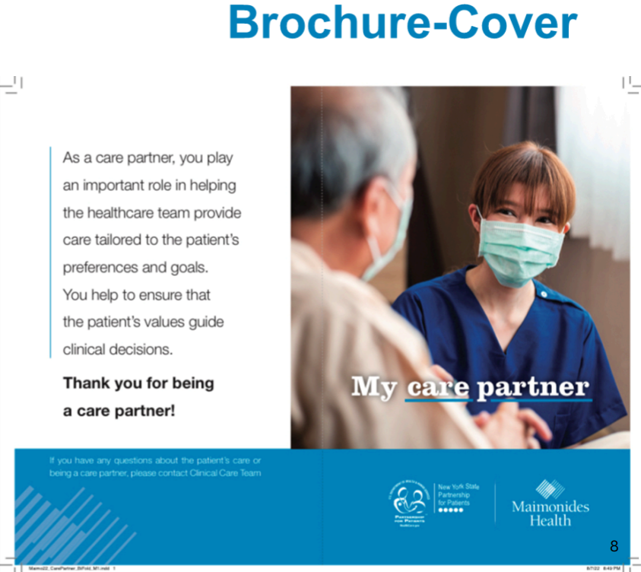
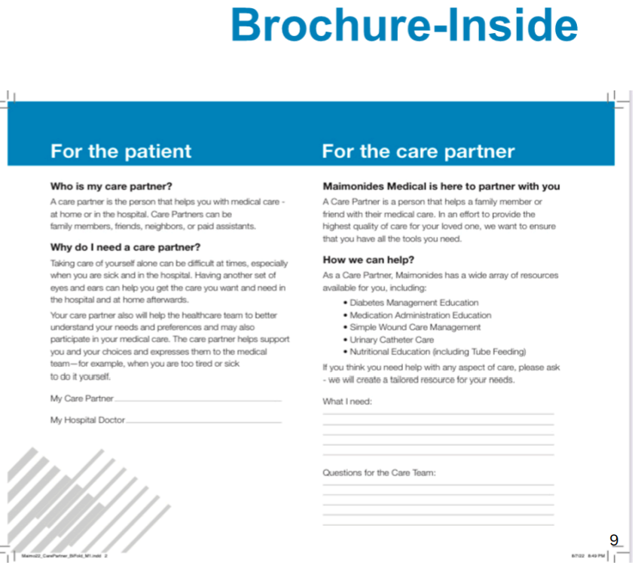
Maimonides Medical Center, NY: Caregiver Brochure

Slide 47
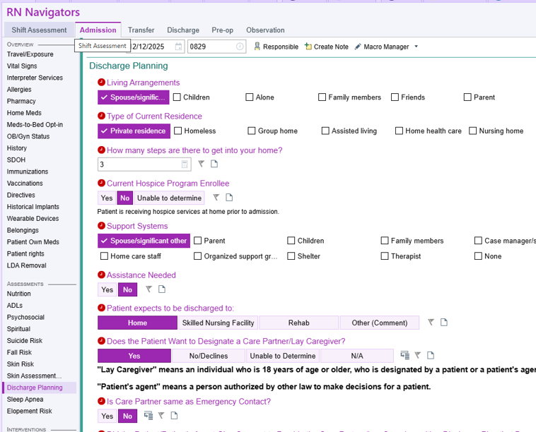
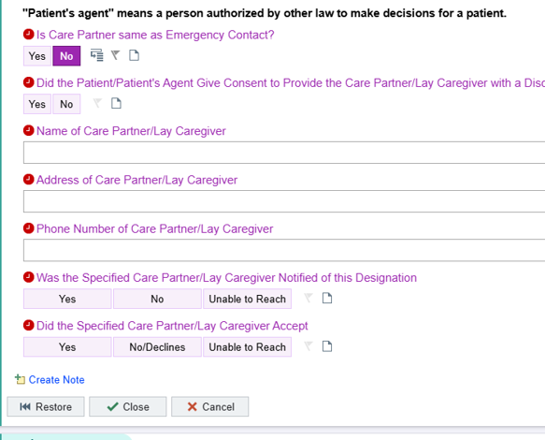
Bayhealth, DE: Sample EHR Capture

Slide 48
Definitions

Slide 49
Clarity on roles
Term | Who It Is | How Chosen | Authority | Typical Uses
Health Care Proxy/Medical Power of Attorney | Designated to make medical decisions if older adult is incapacitated | Chosen by the older adult via legal document | Highest medical decision authority | Medical decisions and communication
Emergency Contact | Person to notify in emergencies | Chosen by the older adult (on forms, verbally captured) | No automatic legal authority | Emergency notification and info sharing
Next of Kin | Closest living relative(s) by law | Defined by law | May have default authority if no health care proxy/medical power of attorney | Inheritance, death decisions, default medical decisions
Notes:
Important notes:
Ensure your staff or whoever may be involved are clear in the difference between a caregiver to that of an emergency contact, health care proxy/medical power of attorney, and next of kin.
You can use this or adapt something like this to help provide clarity. Health care proxy is also known as health care agent, medical power of attorney/power of attorney for health care decisions, or surrogate decision-maker.
Consider role clarity when discussing with older adults.
Next of Kin laws vary by state.
Sources:
https://www.caringinfo.org/
https://uslawexplained.com/next_of_kin
https://catalystlegal.org/how-next-kin-is-determined-law-clear/
https://www.hipaanswers.com/is-calling-an-emergency-contact-a-hipaa-violation/
https://www.nolo.com/legal-encyclopedia/your-emergency-contact-it-matters.html
https://www.cobrief.app/resources/legal-glossary/emergency-contact-overview-definition-and-example
https://governancepedia.com/encyclopedia/emergency-contacts/

